Slide 1


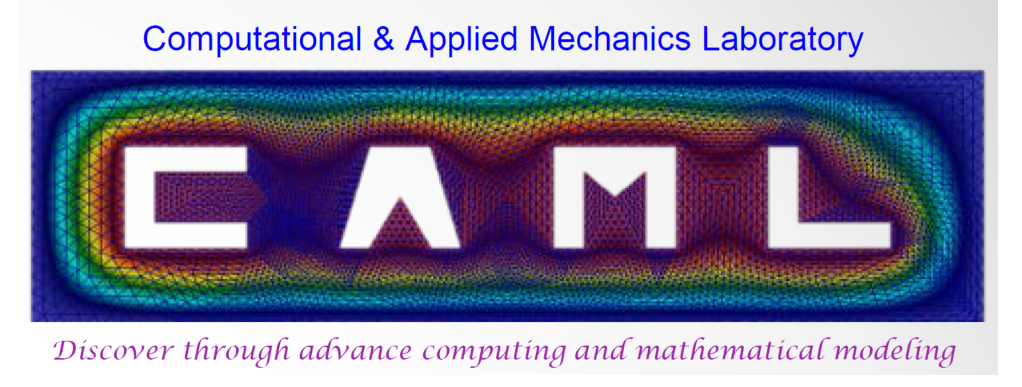
FEniCS workshop
June 2018
Mohammad Sarraf Joshaghani
CACDS Fellow
Graduate student @CAML
Advisor: Prof. Kalyana Nakshatrala

Slide 2


Slide 3


Slide 4
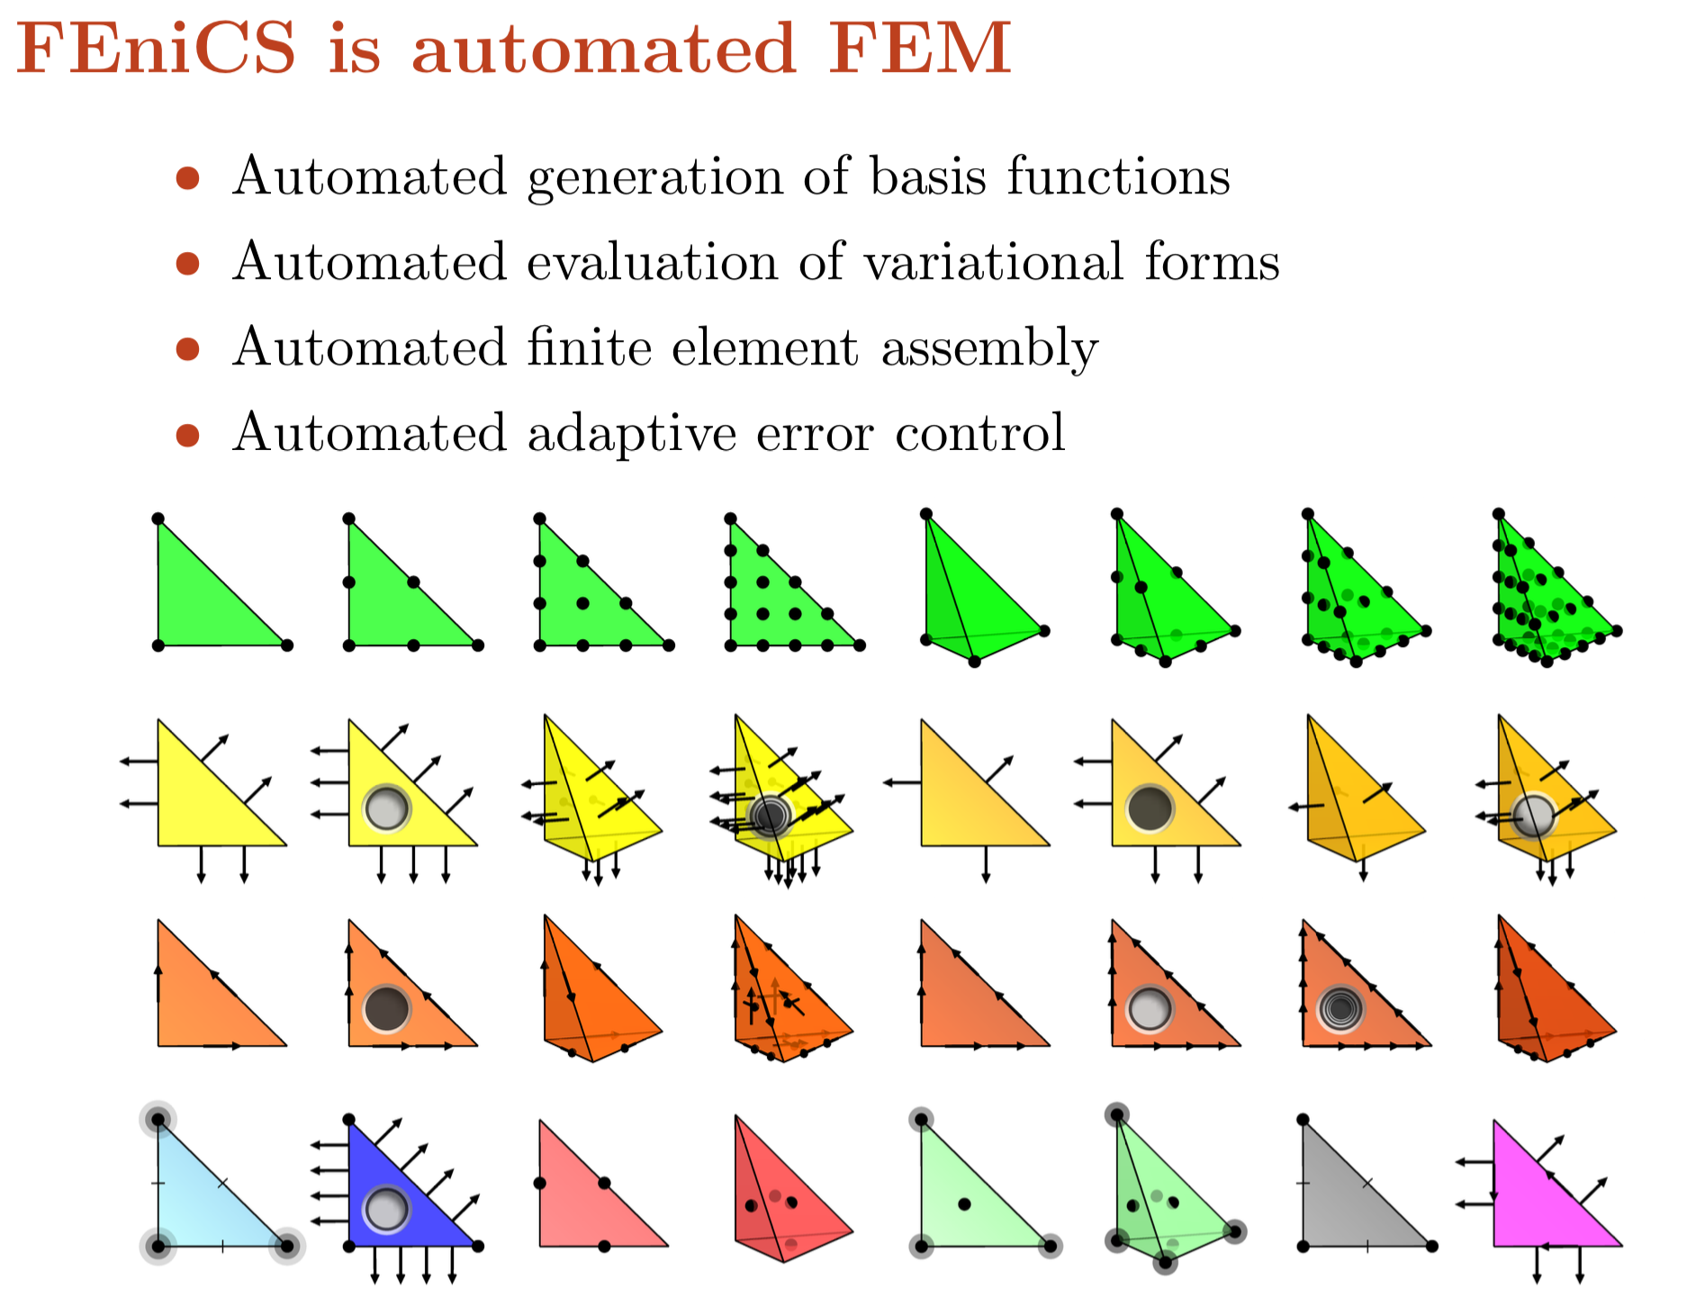

Slide 5
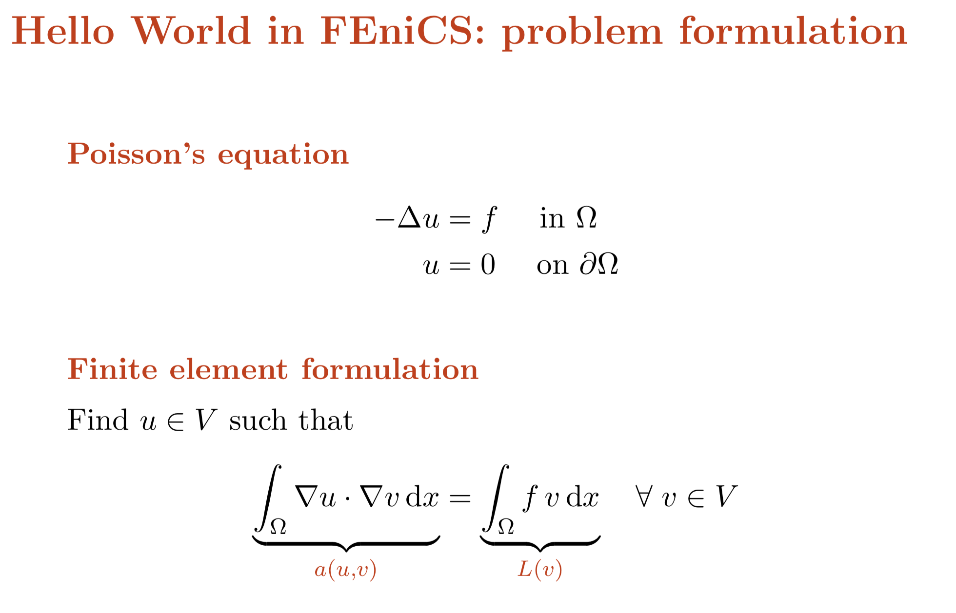

Slide 6
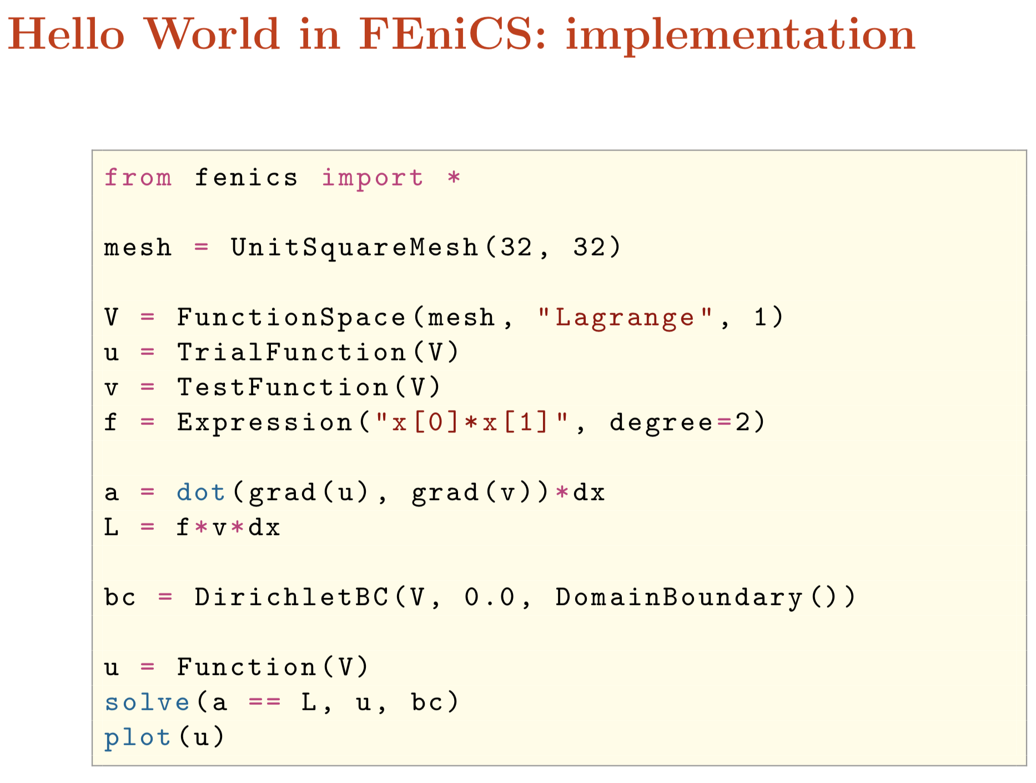

Slide 7
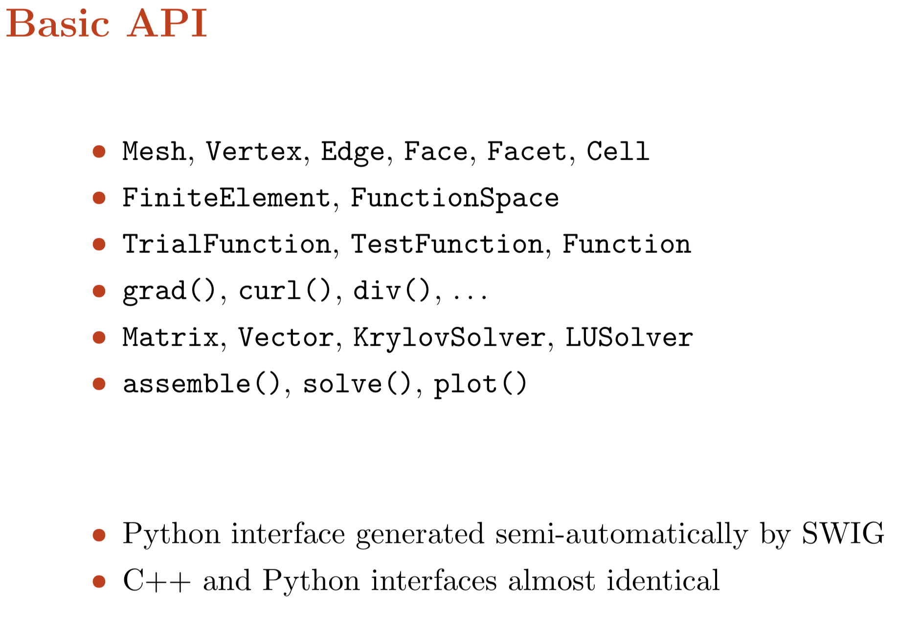

Slide 8


Slide 9
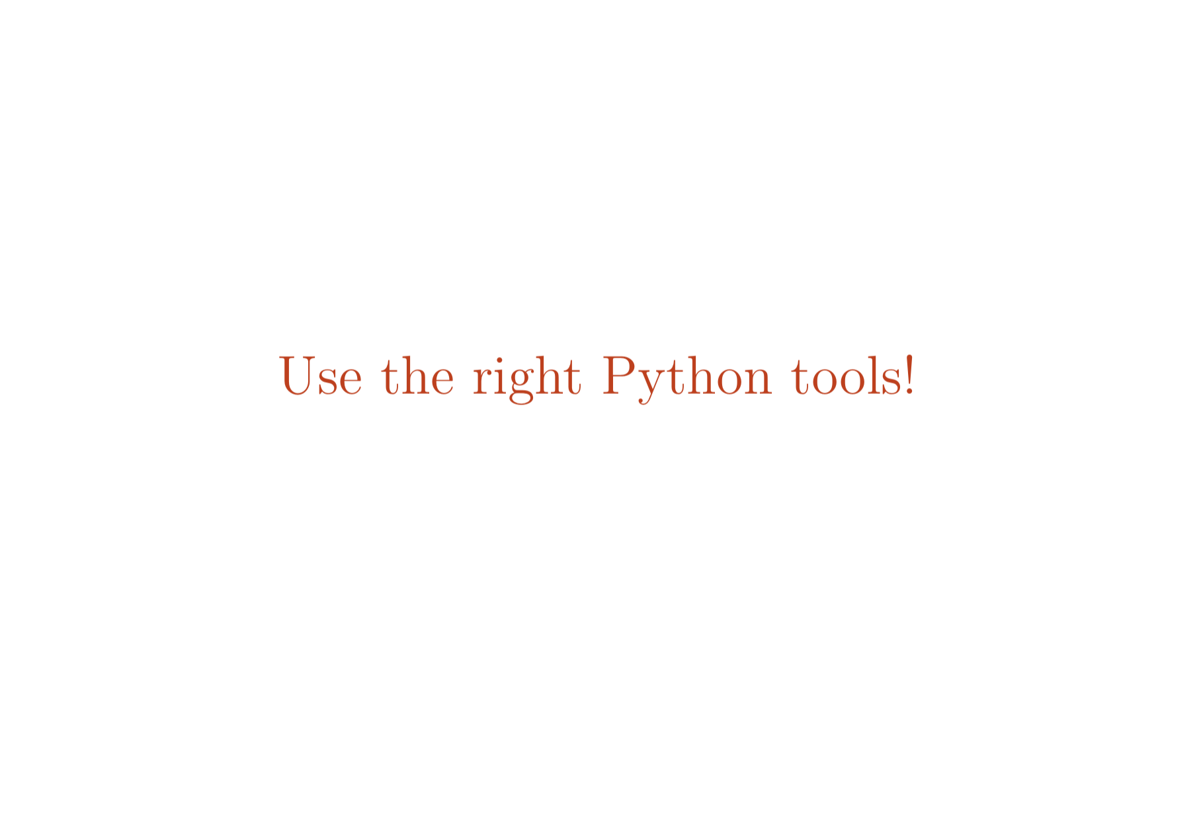

Slide 10
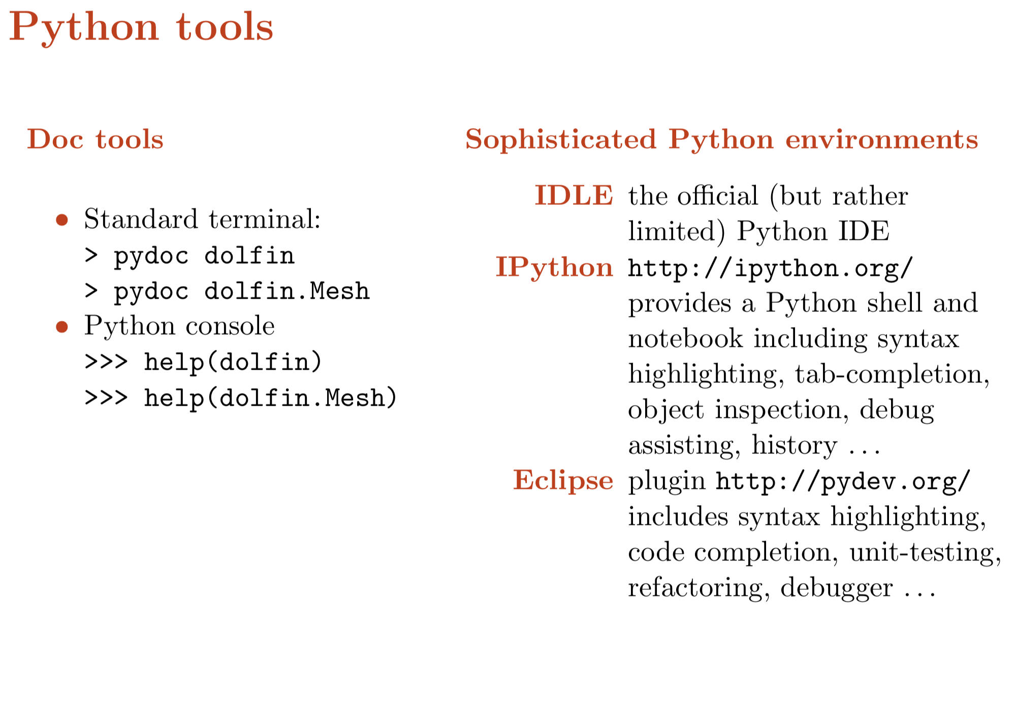

Slide 11
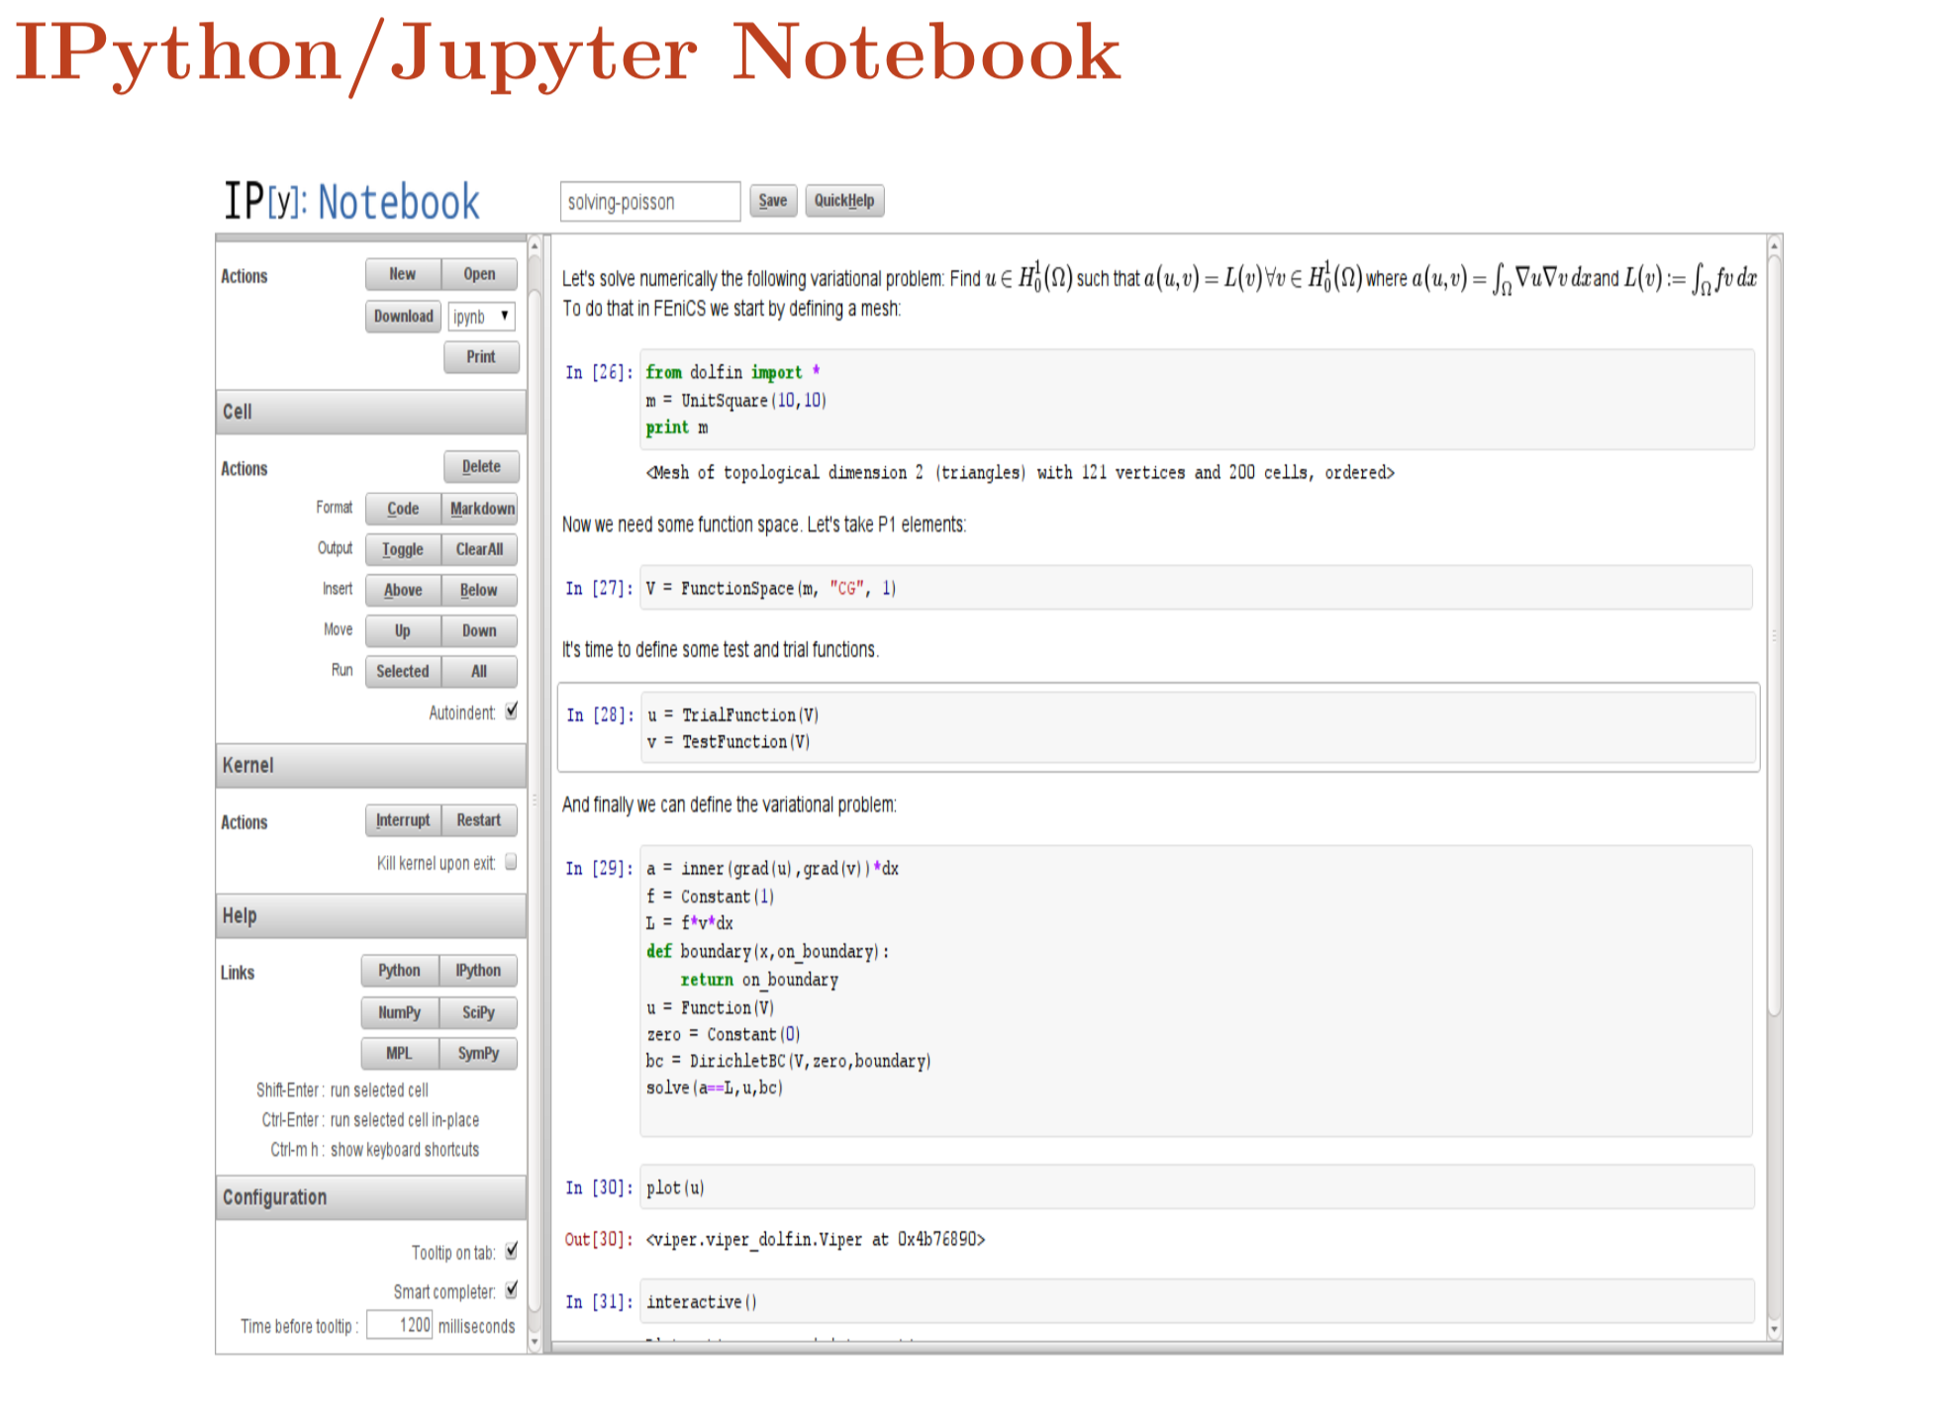

Slide 12
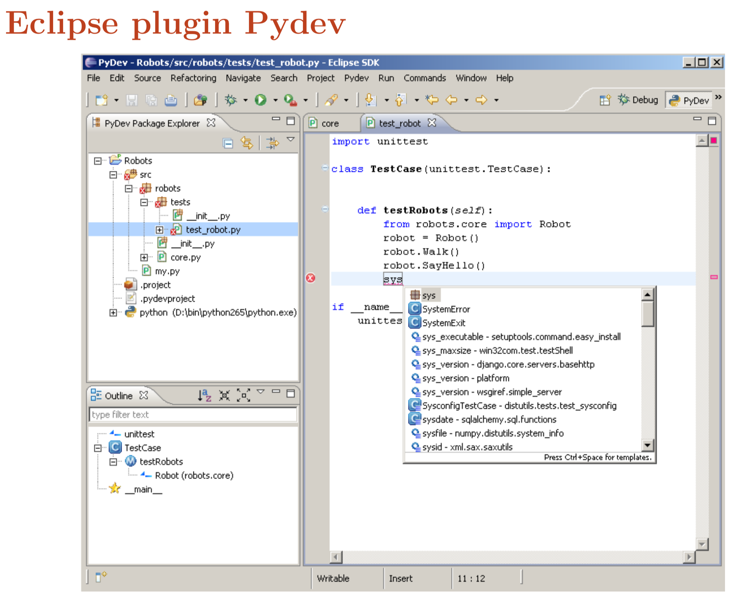

Slide 13


Slide 14
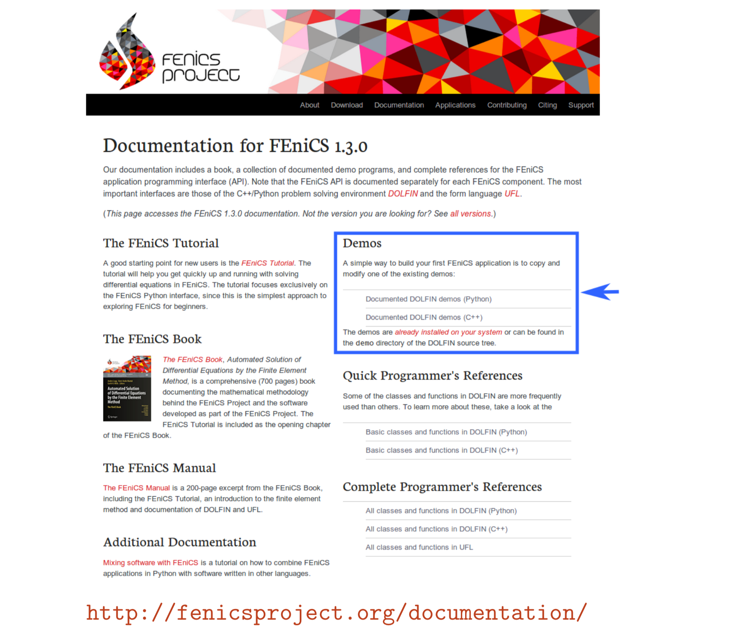

Slide 15
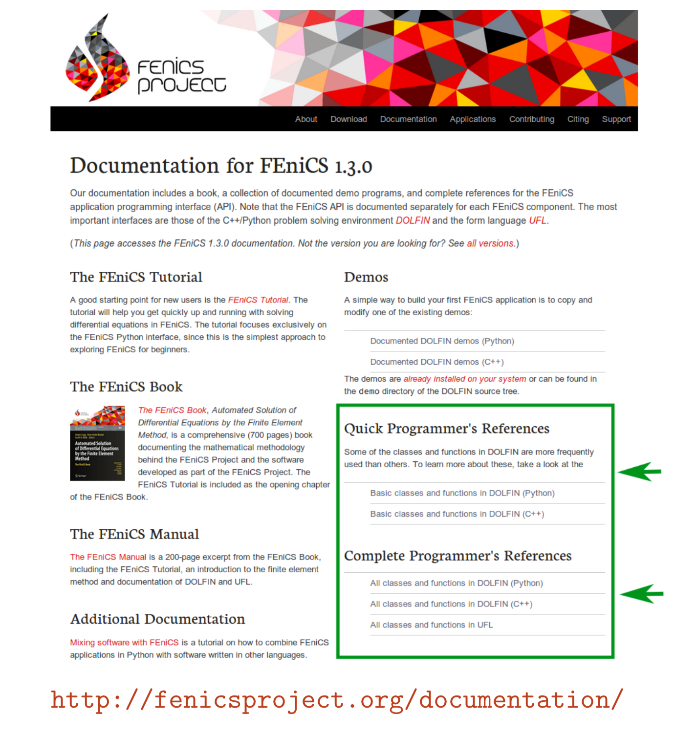

Slide 16
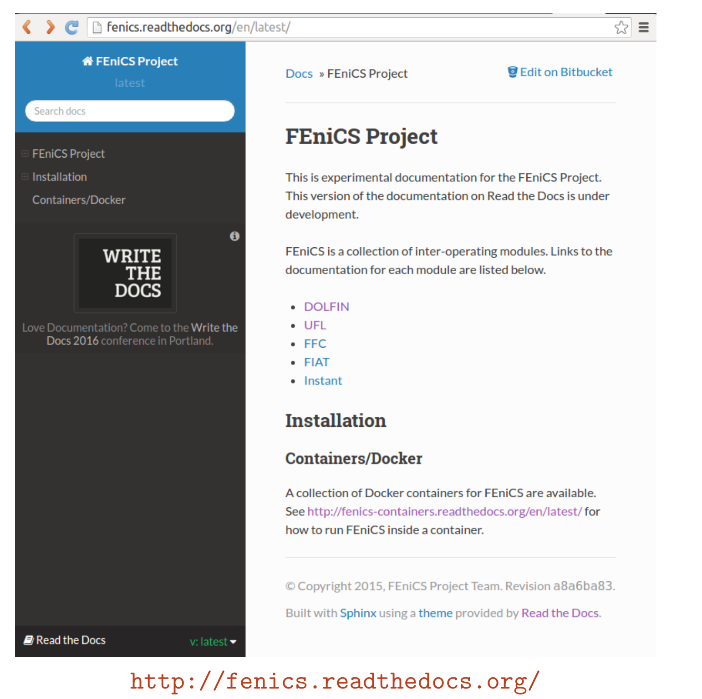

Slide 17


Slide 18
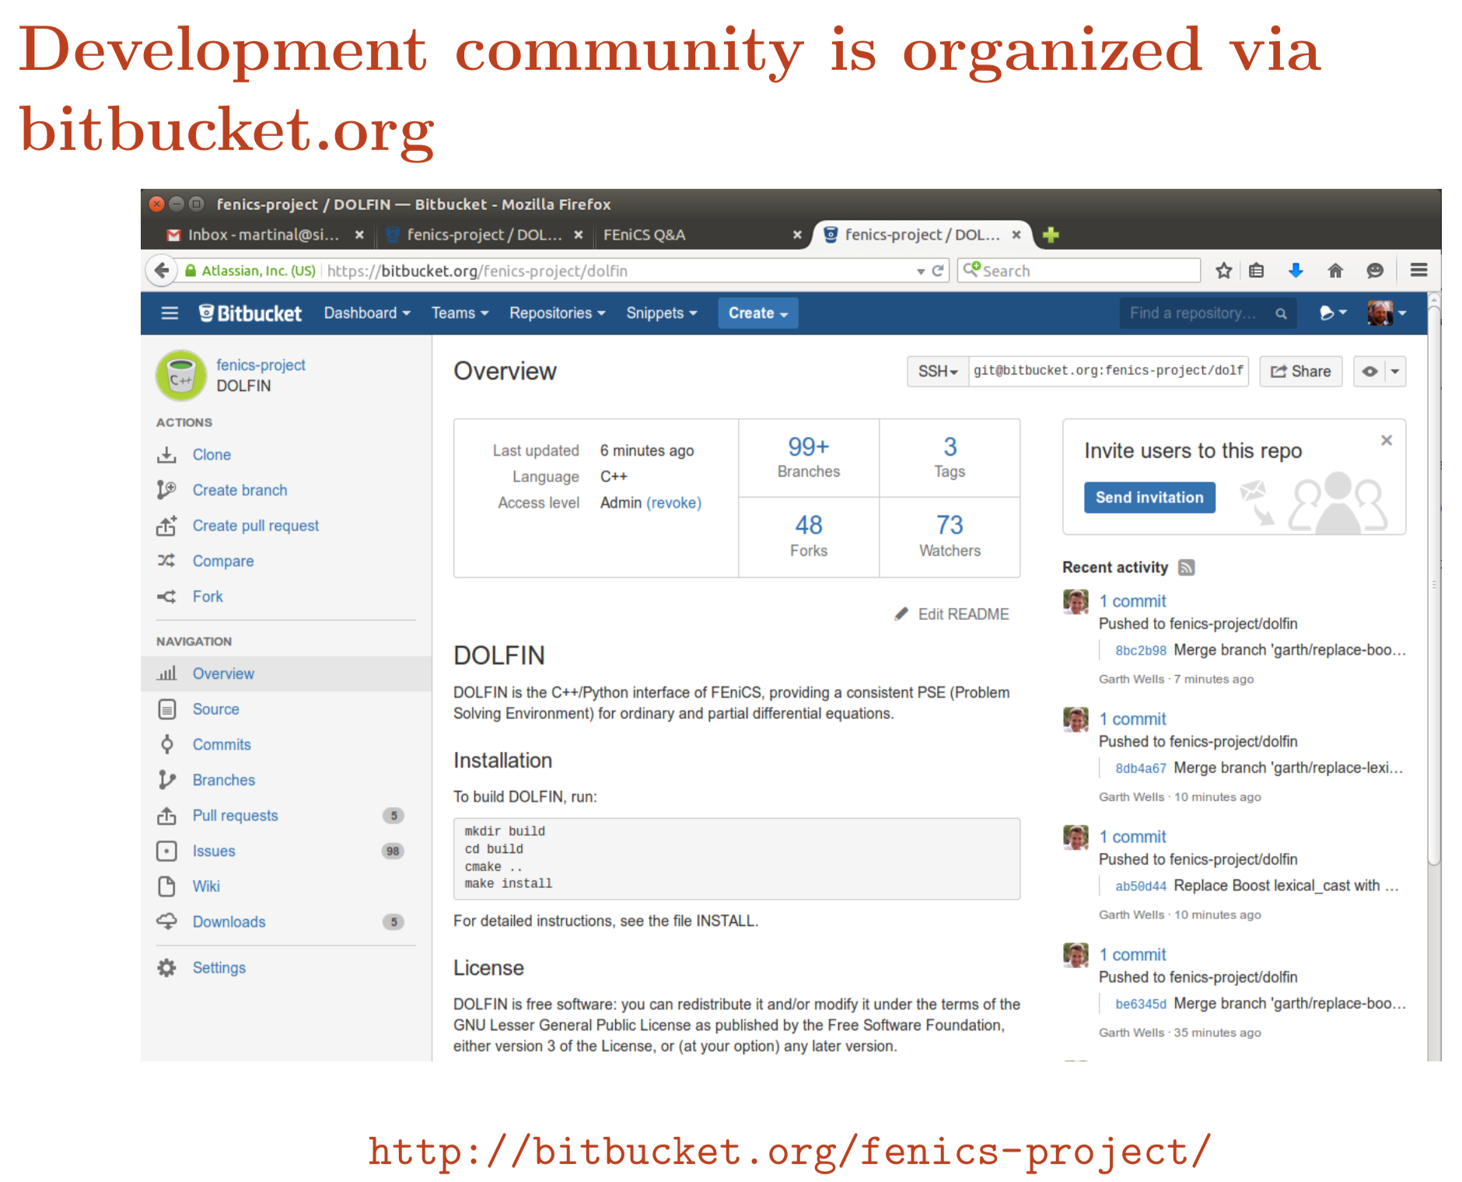

Slide 19
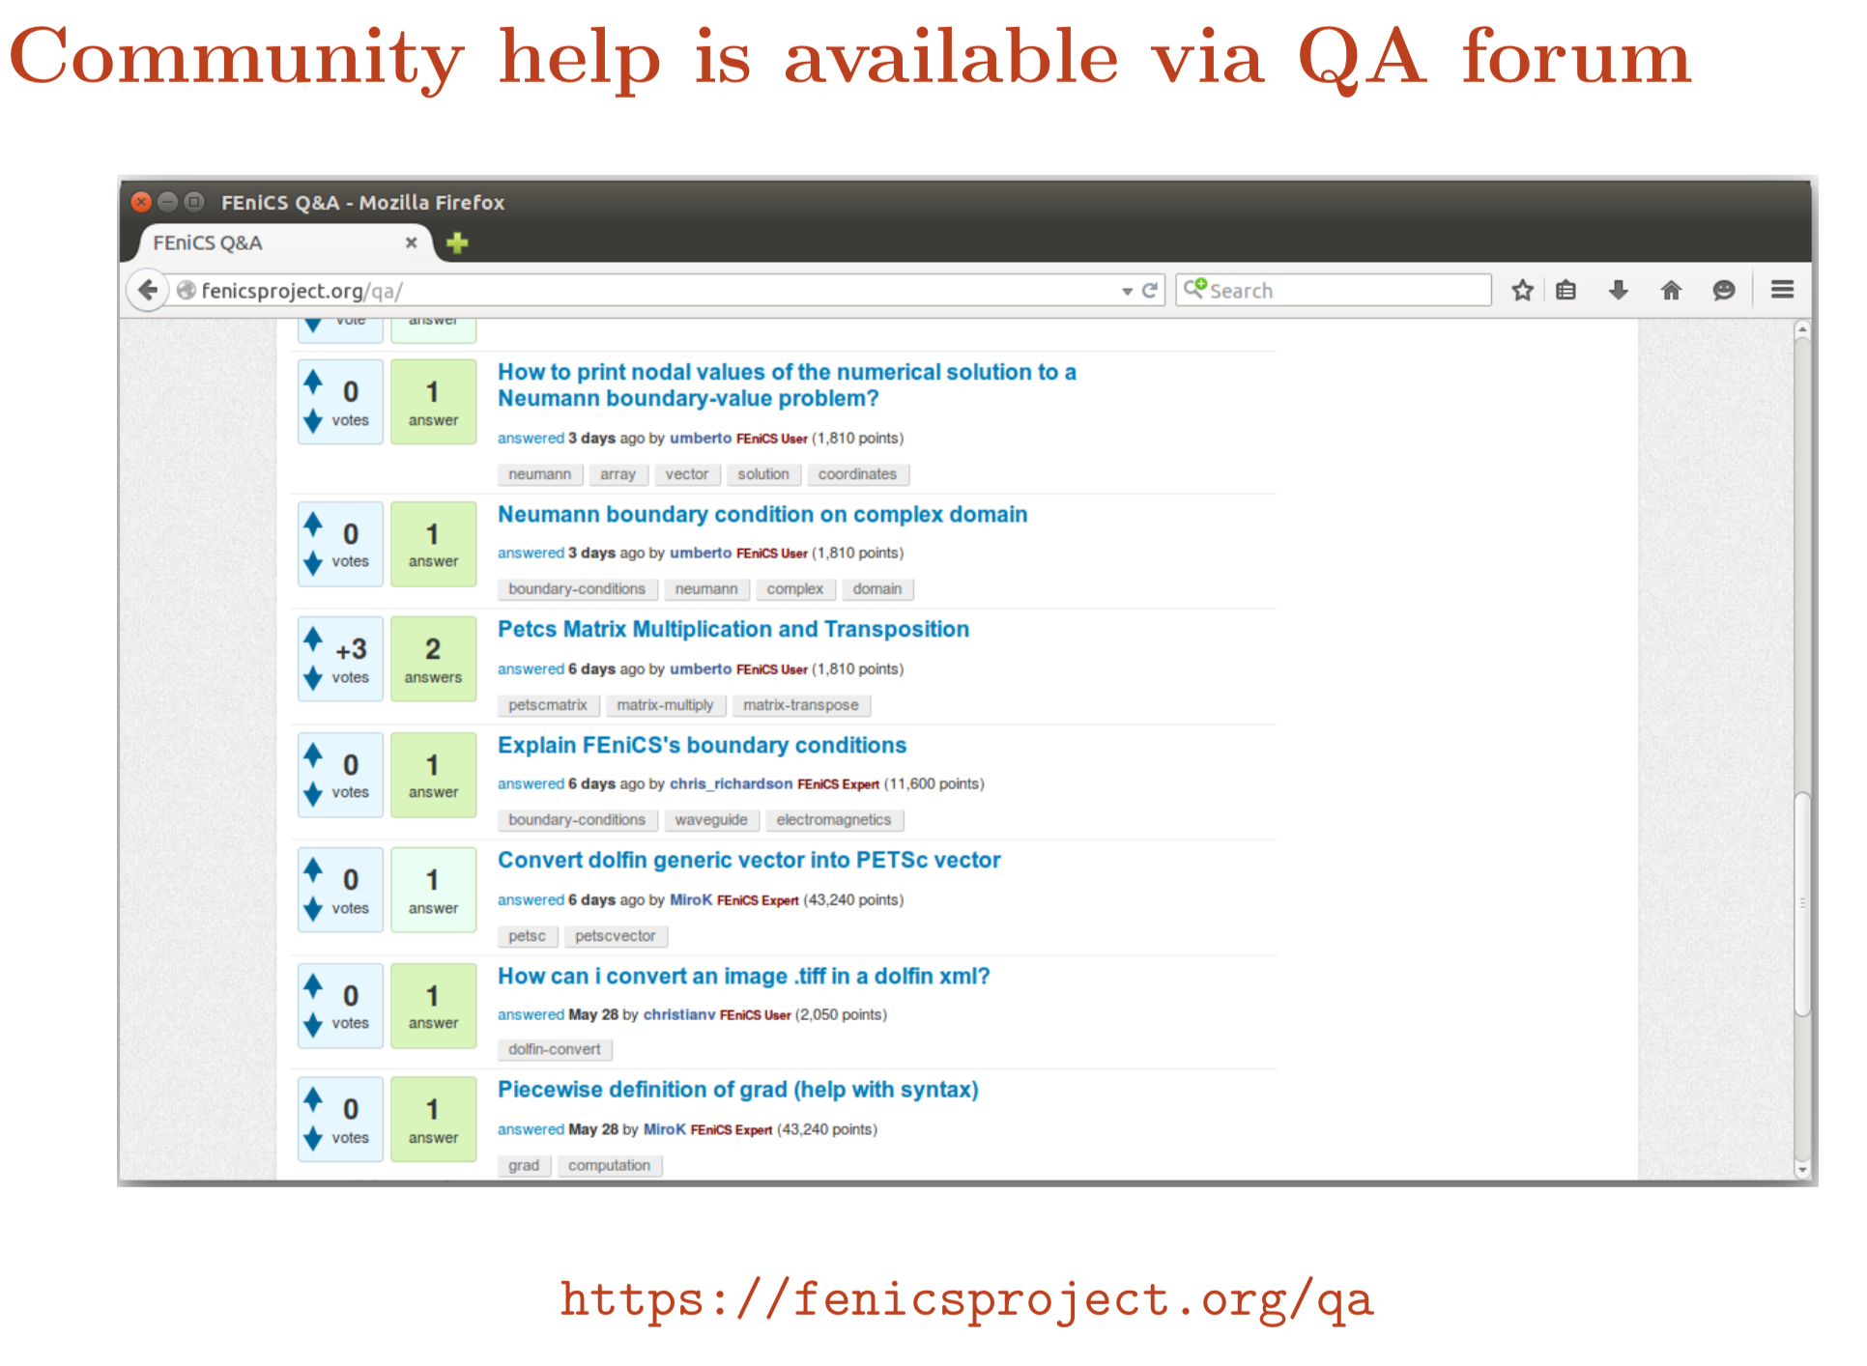

Slide 21
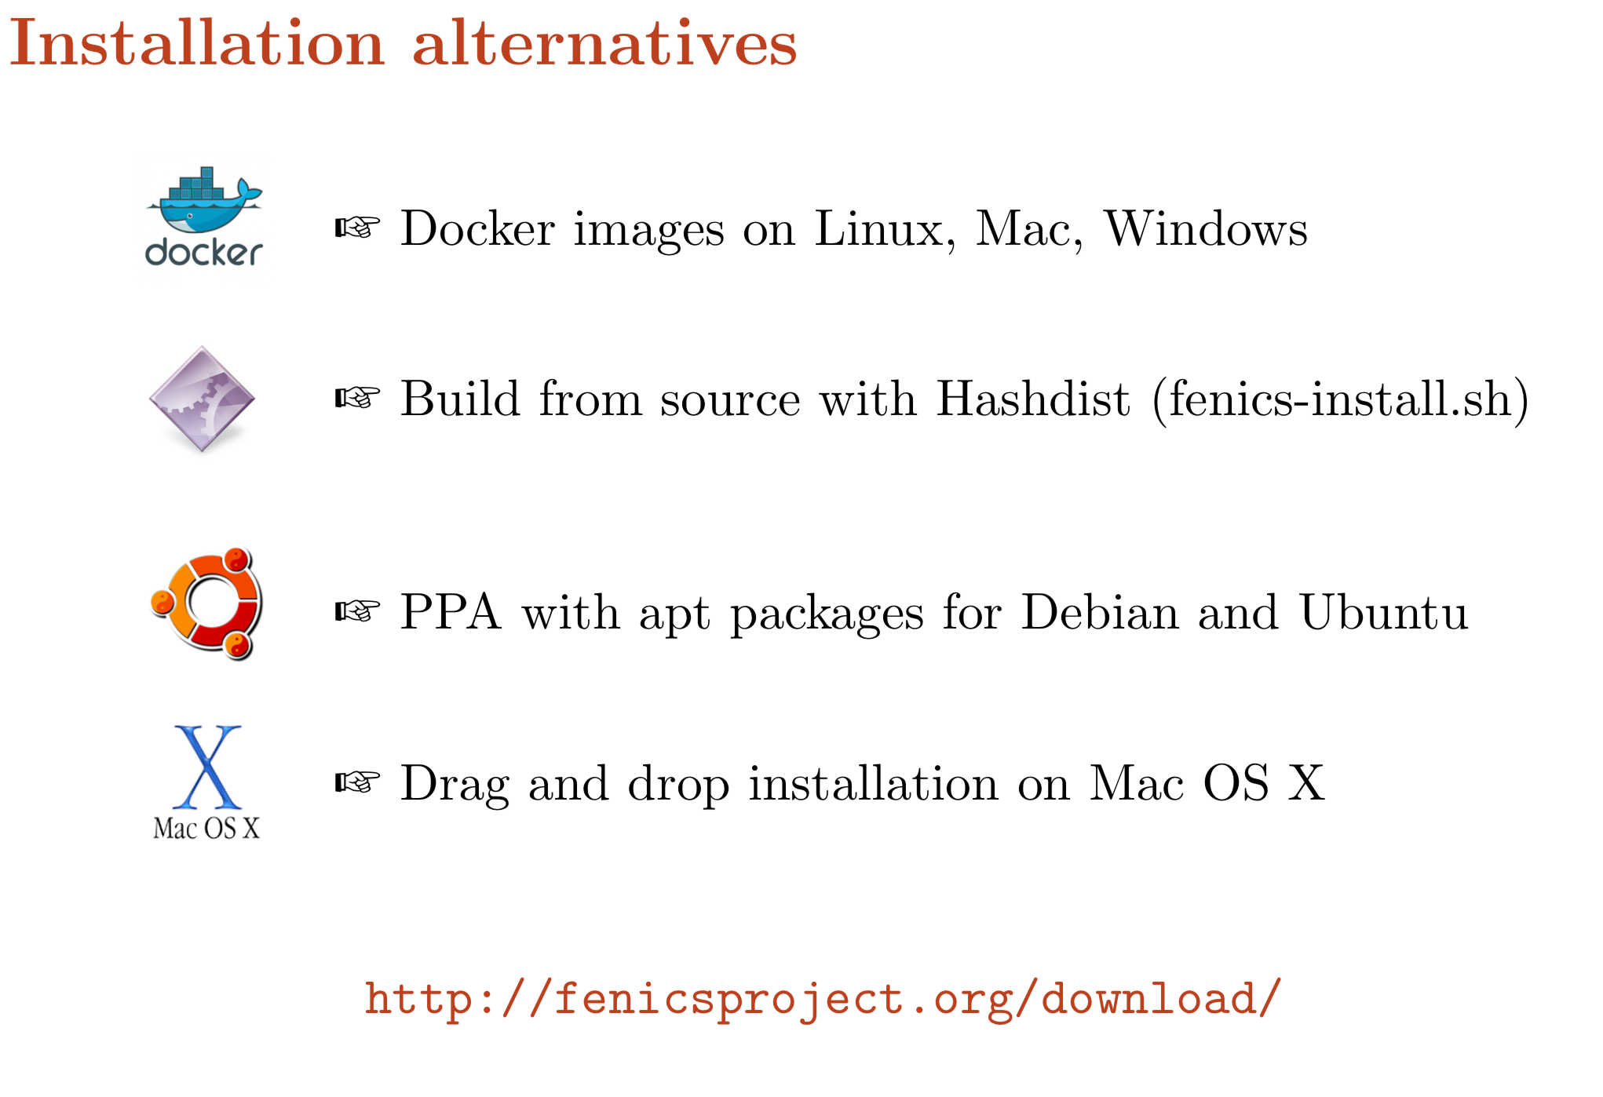

Slide 22
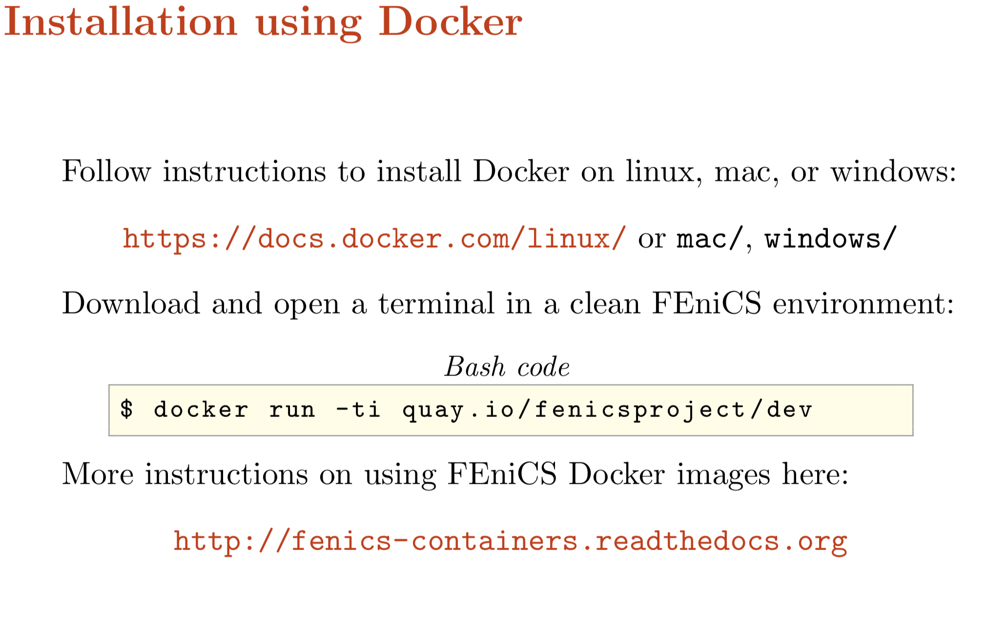

Slide 23

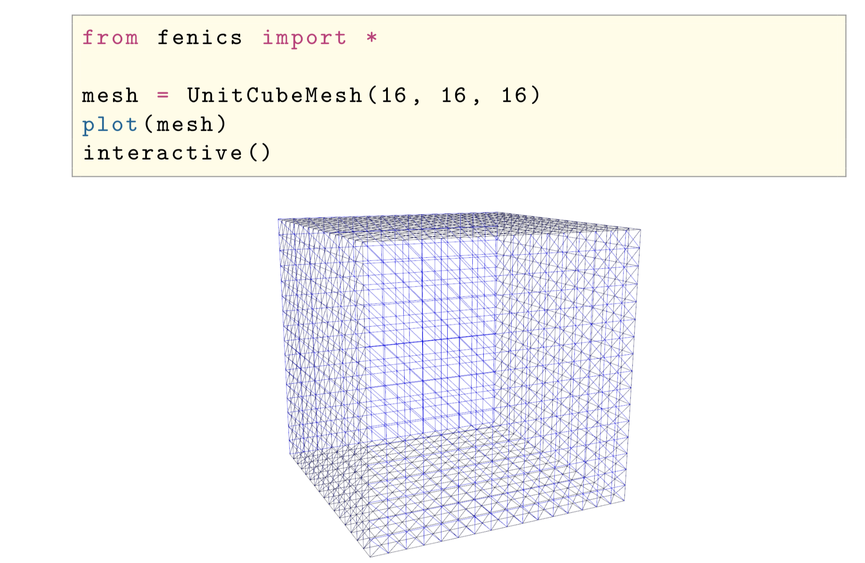
Step 1. Sharing files from the host (your computer) into the docker container
docker run -ti -v $(pwd):/home/fenics/shared quay.io/fenicsproject/stable
Step 2. Use an editor and generate the following < >.py file.
Step 3. run the code

Slide 24
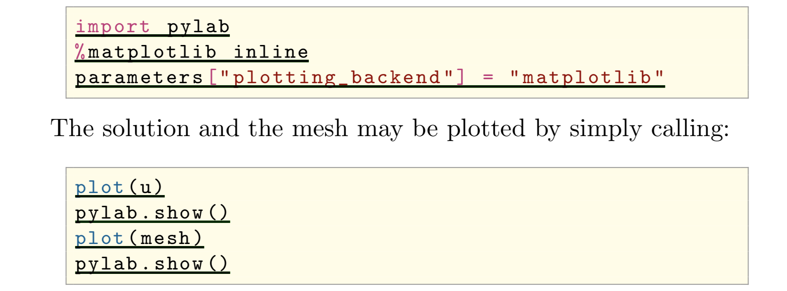
1- First of all we run a new Docker container with the jupyter-notebook
docker run --name notebook -w /home/fenics -v $(pwd):/home/fenics/shared -d -p 127.0.0.1:8888:8888 quay.io/fenicsproject/stable 'jupyter-notebook --ip=0.0.0.0'
2- Figure out what is your container ID
docker ps
3- Find out the access token
docker logs <cointainer ID>
4- Paste log-in token in browser
5- For visualization, import pylab

Slide 25

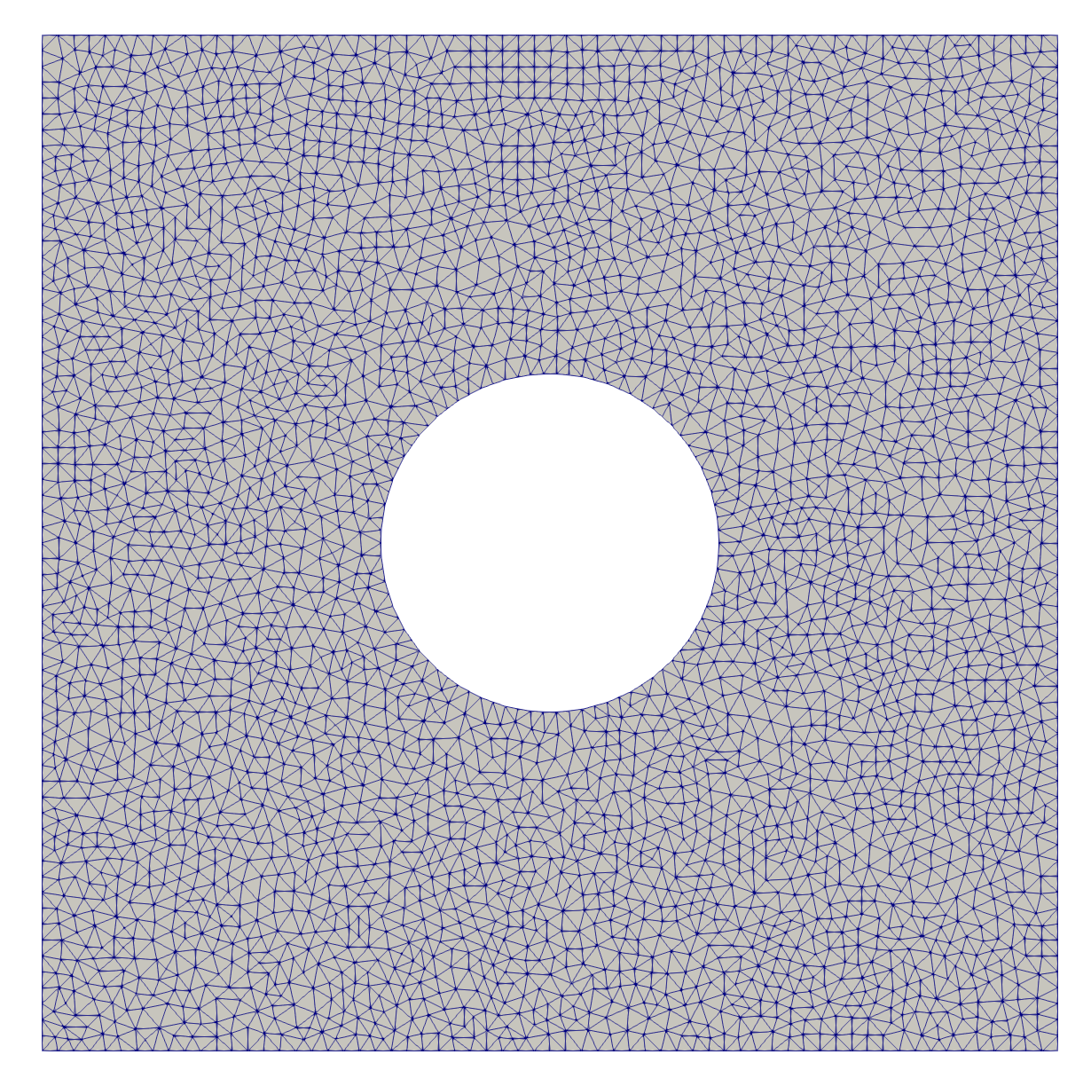
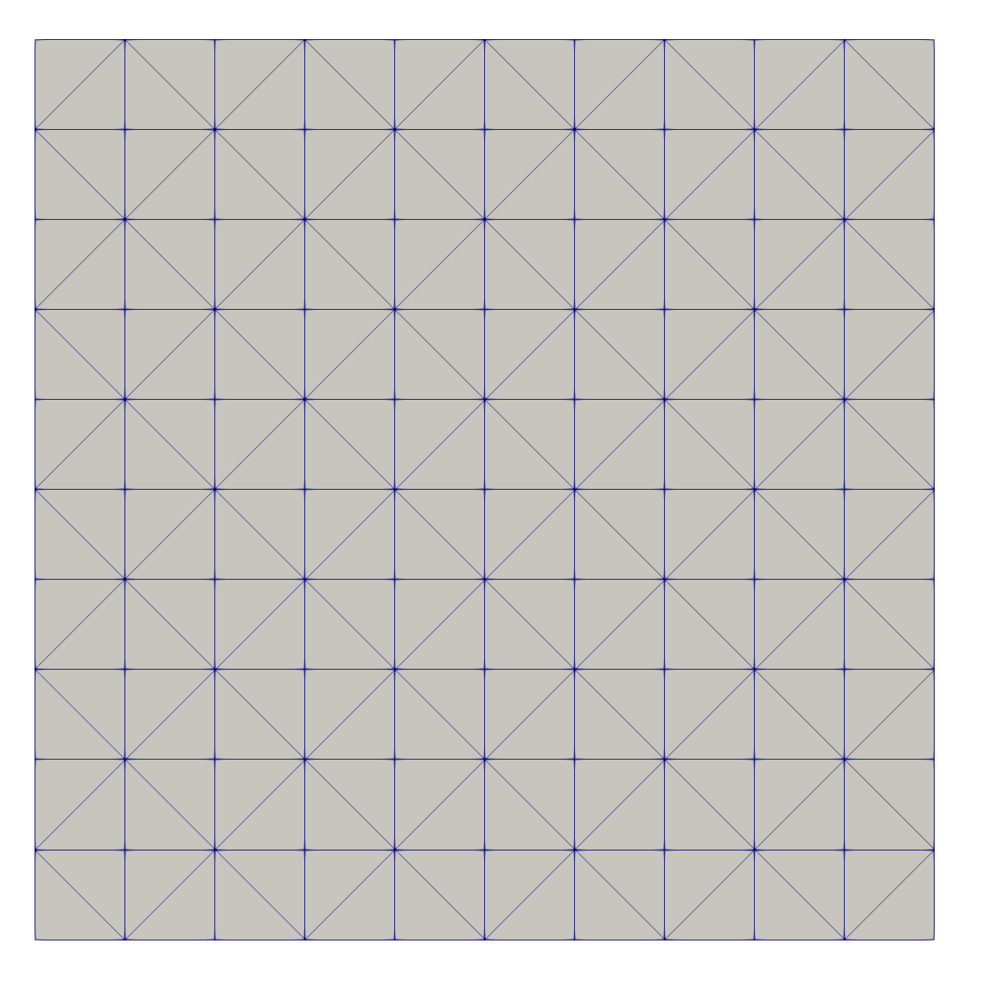
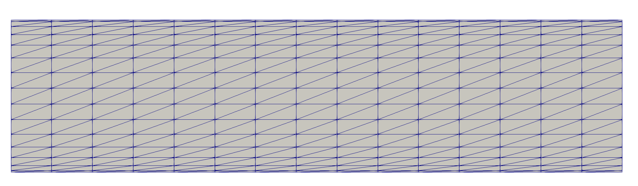
Mesh generation
Write a python code to generate the following domains and meshes:
Mesh 2
Mesh 1
Mesh 3

Slide 26
git clone https://github.com/msarrafj/FEniCS.git

Slide 28
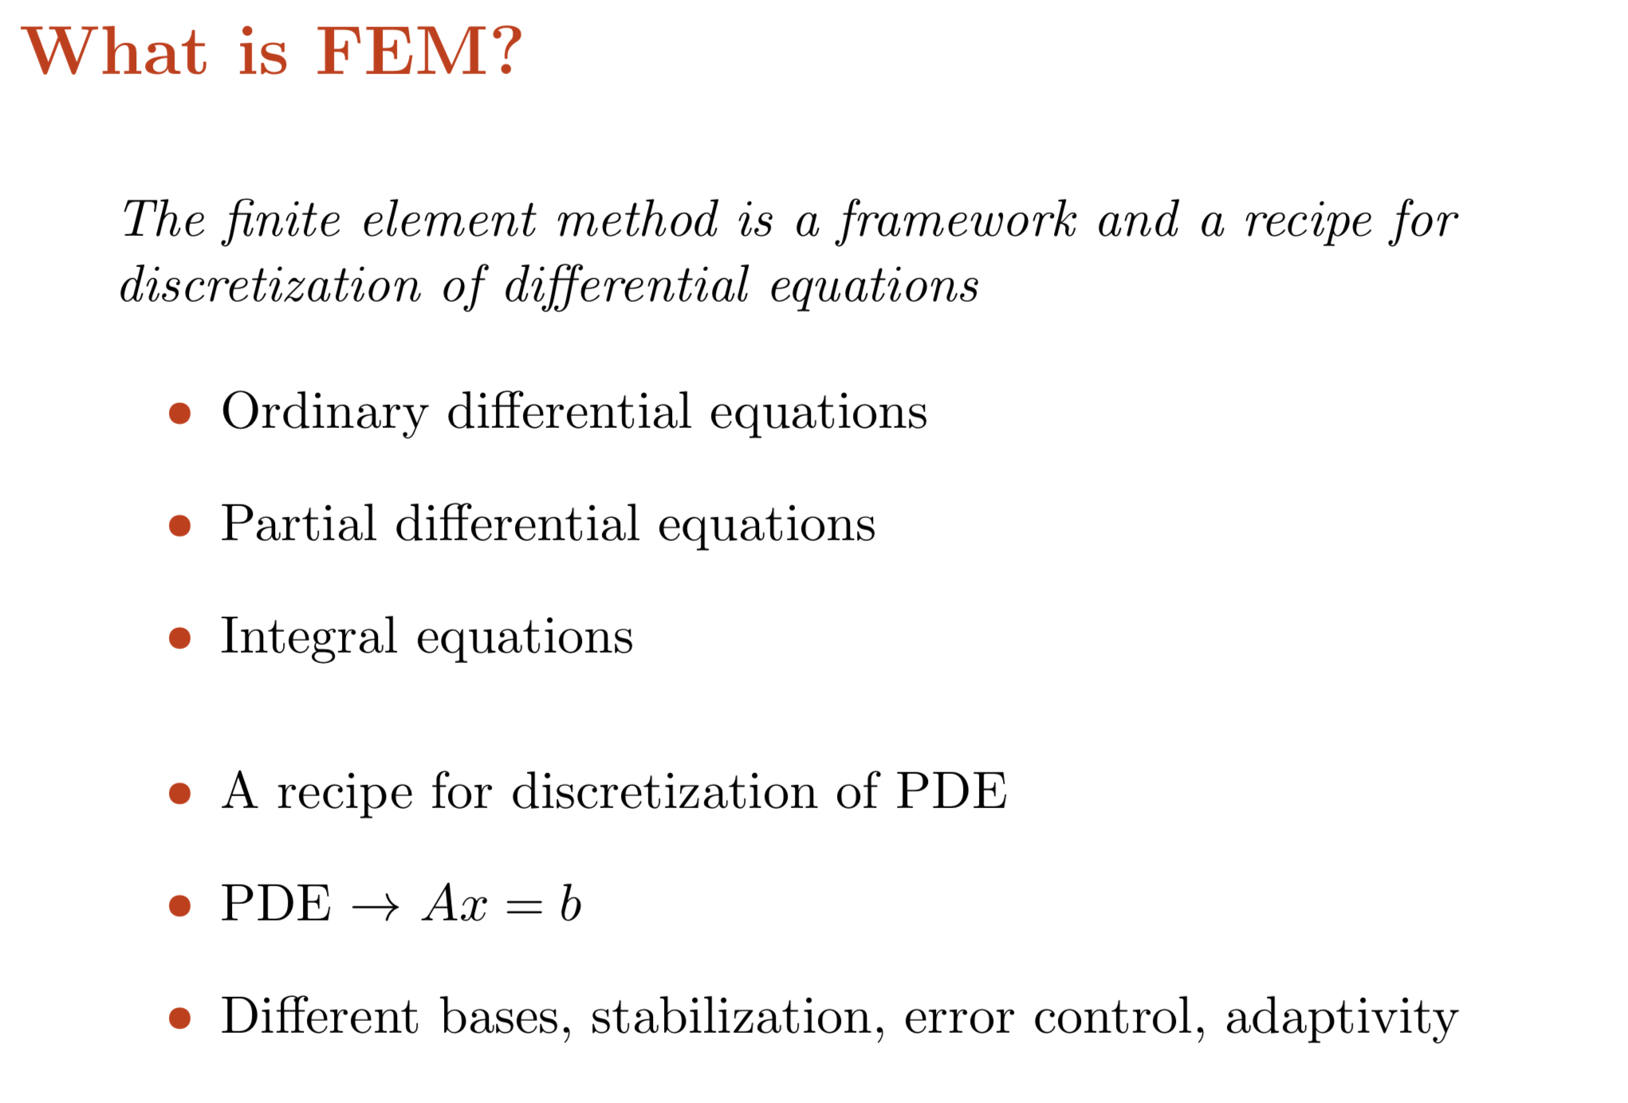

Slide 29
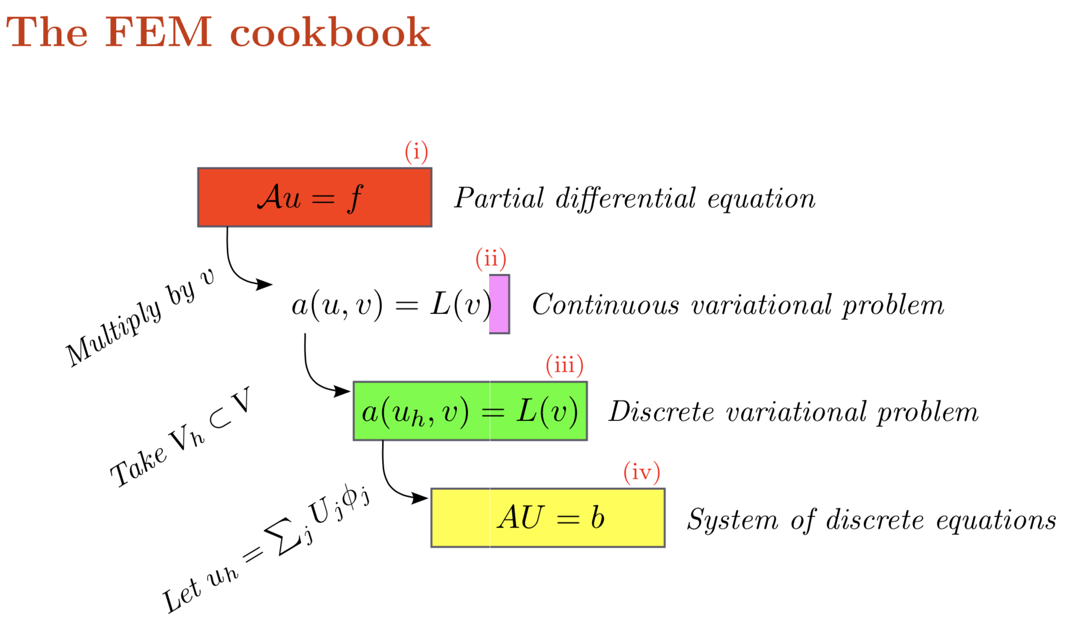

Slide 30
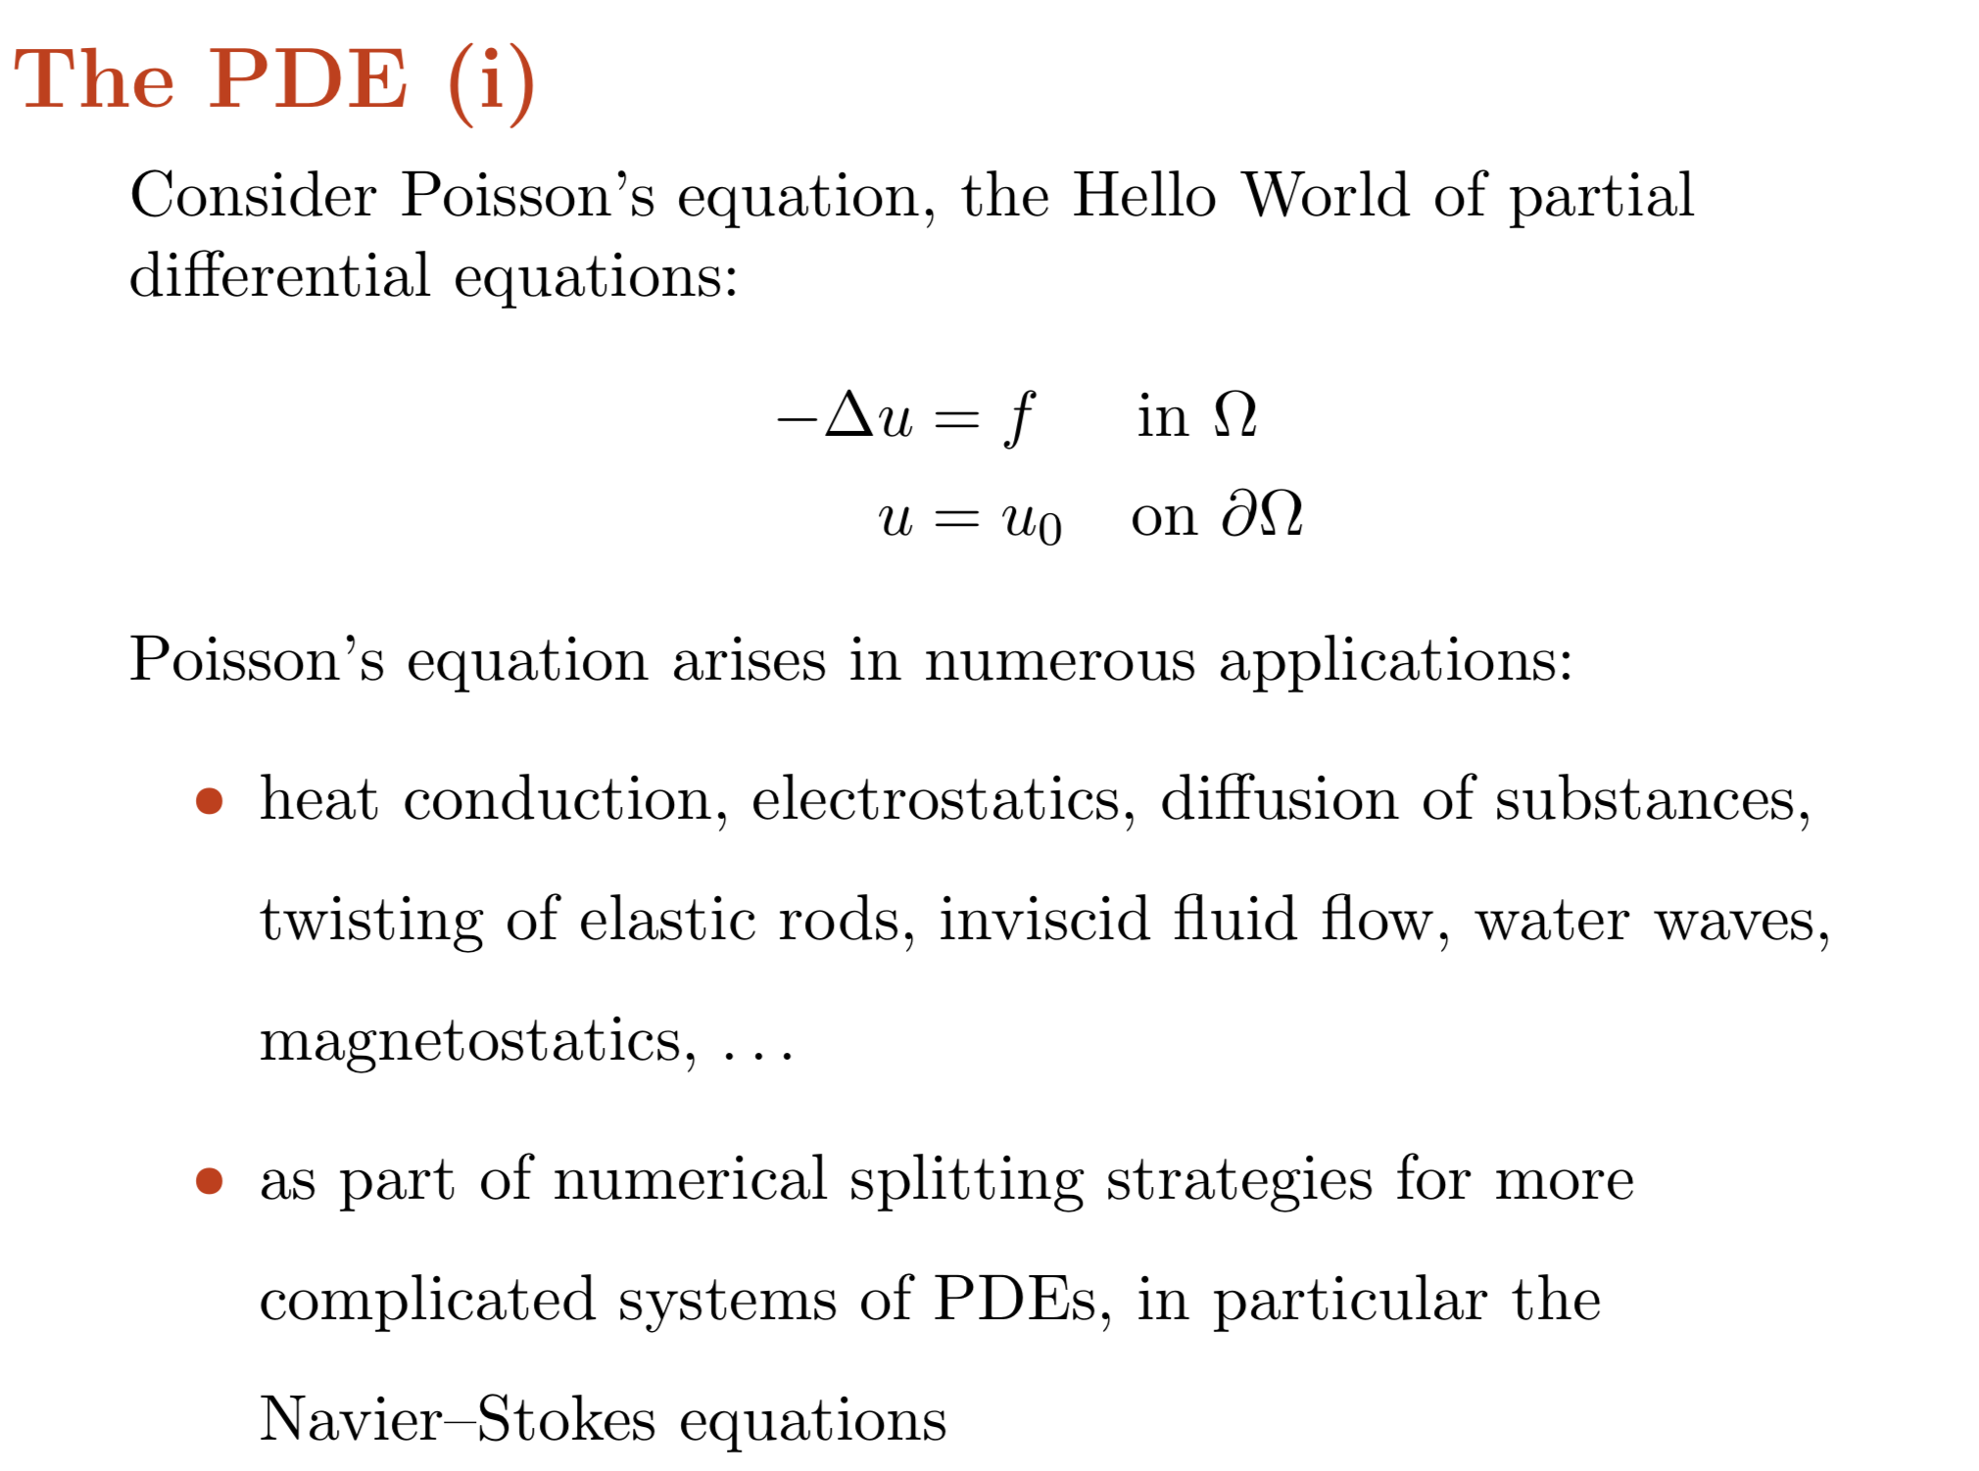

Slide 31
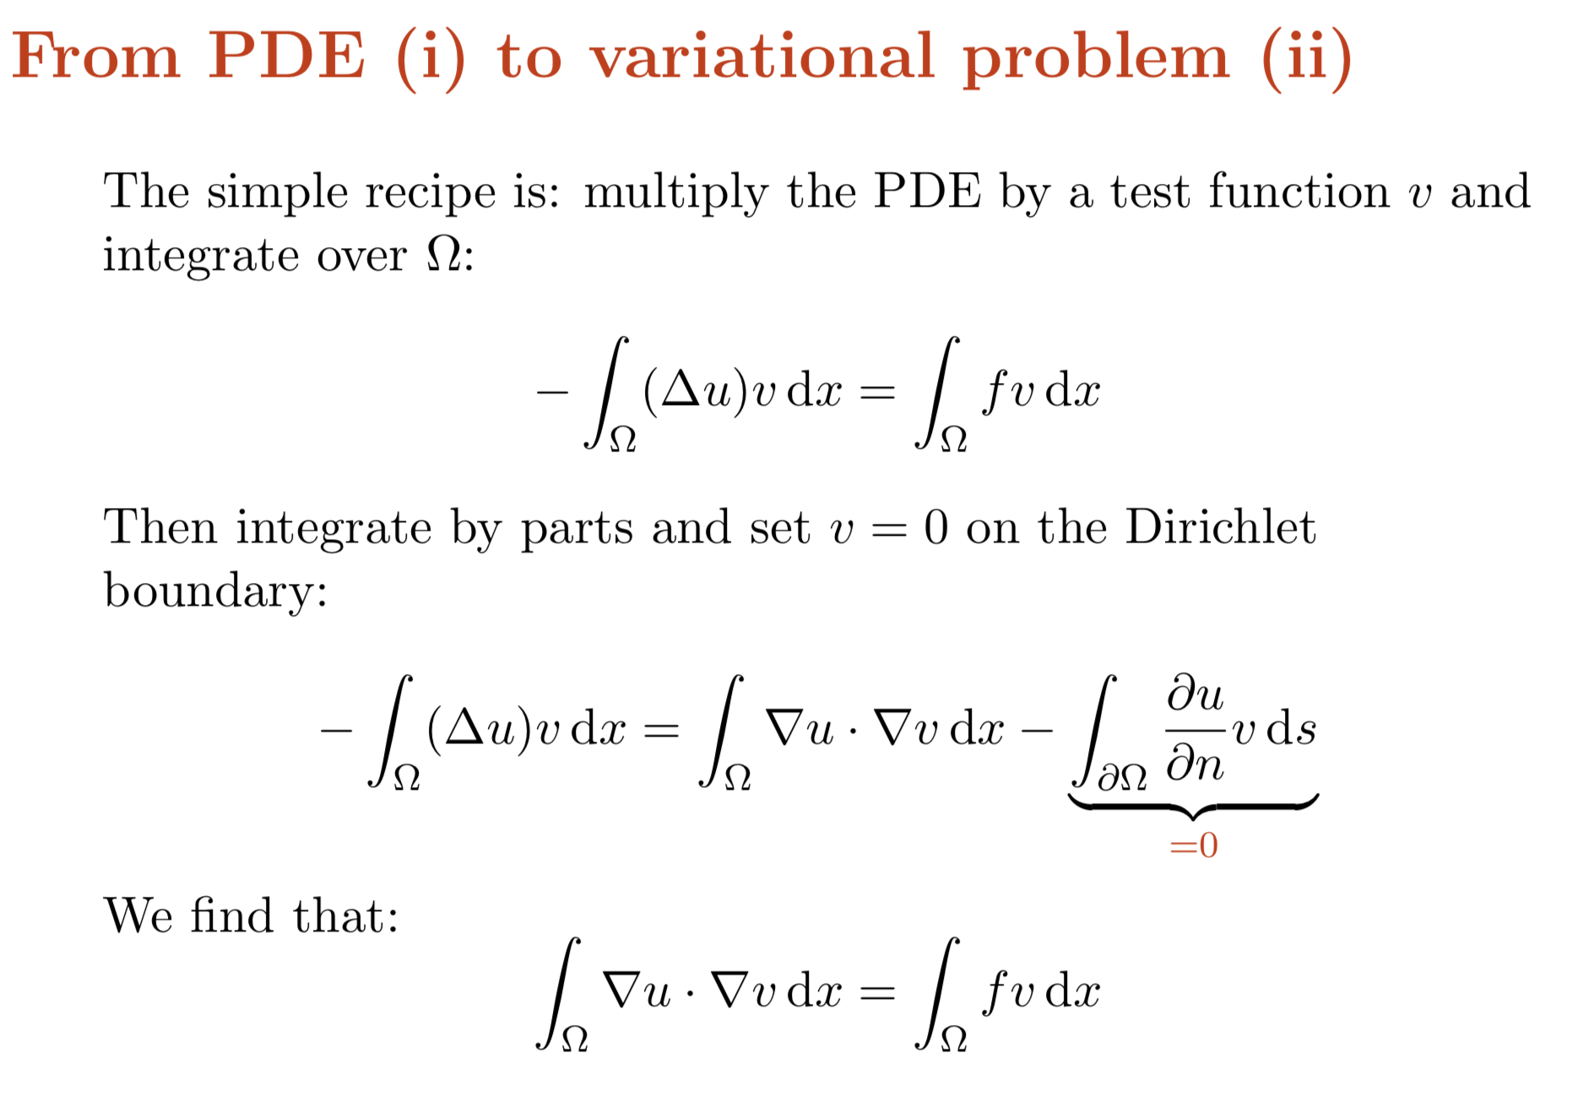

Slide 32
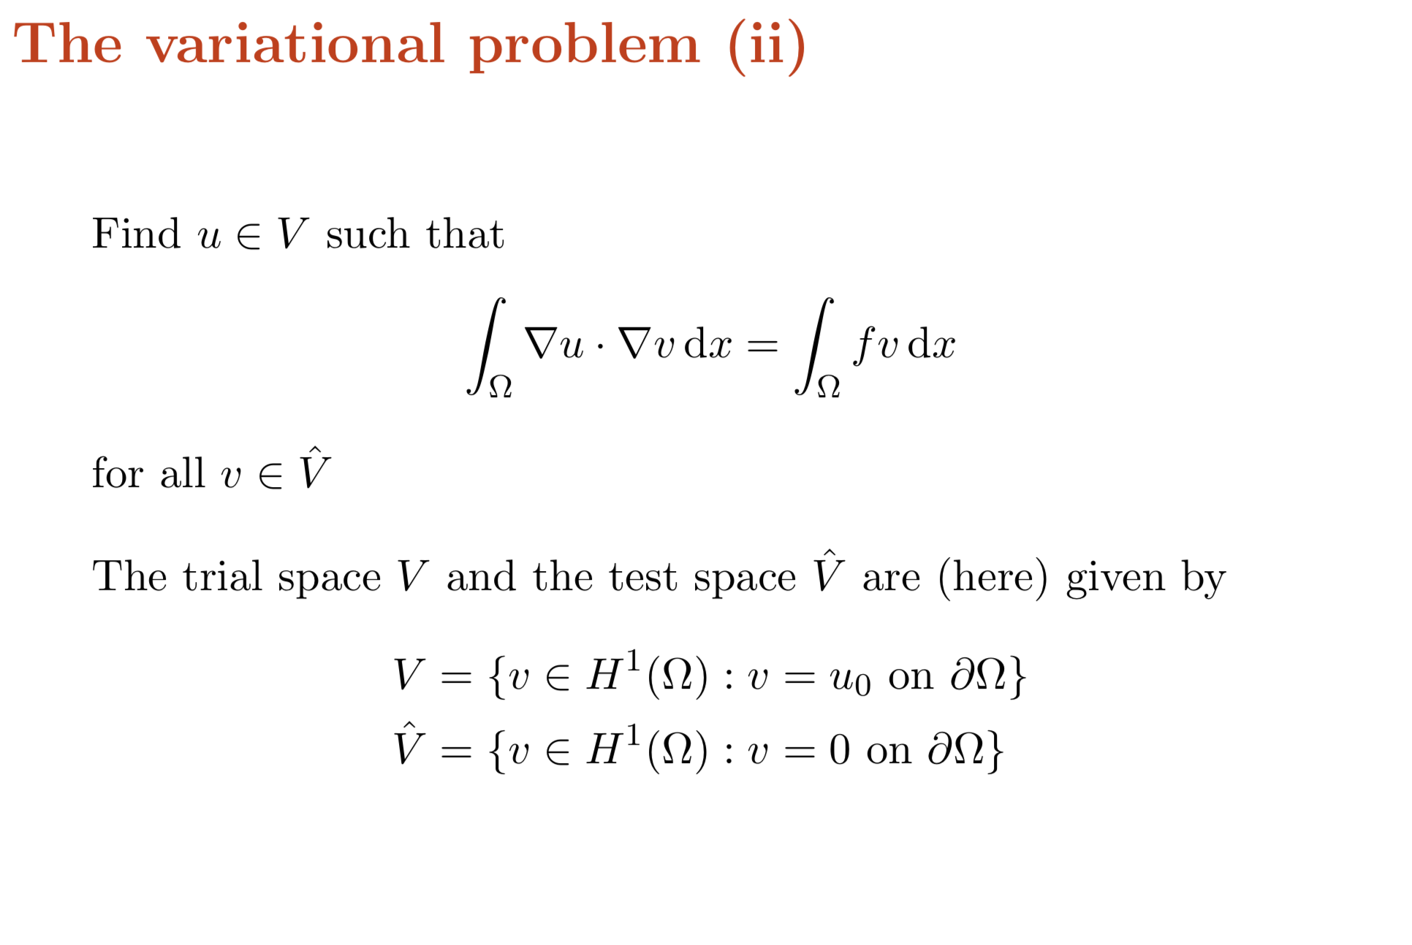

Slide 33
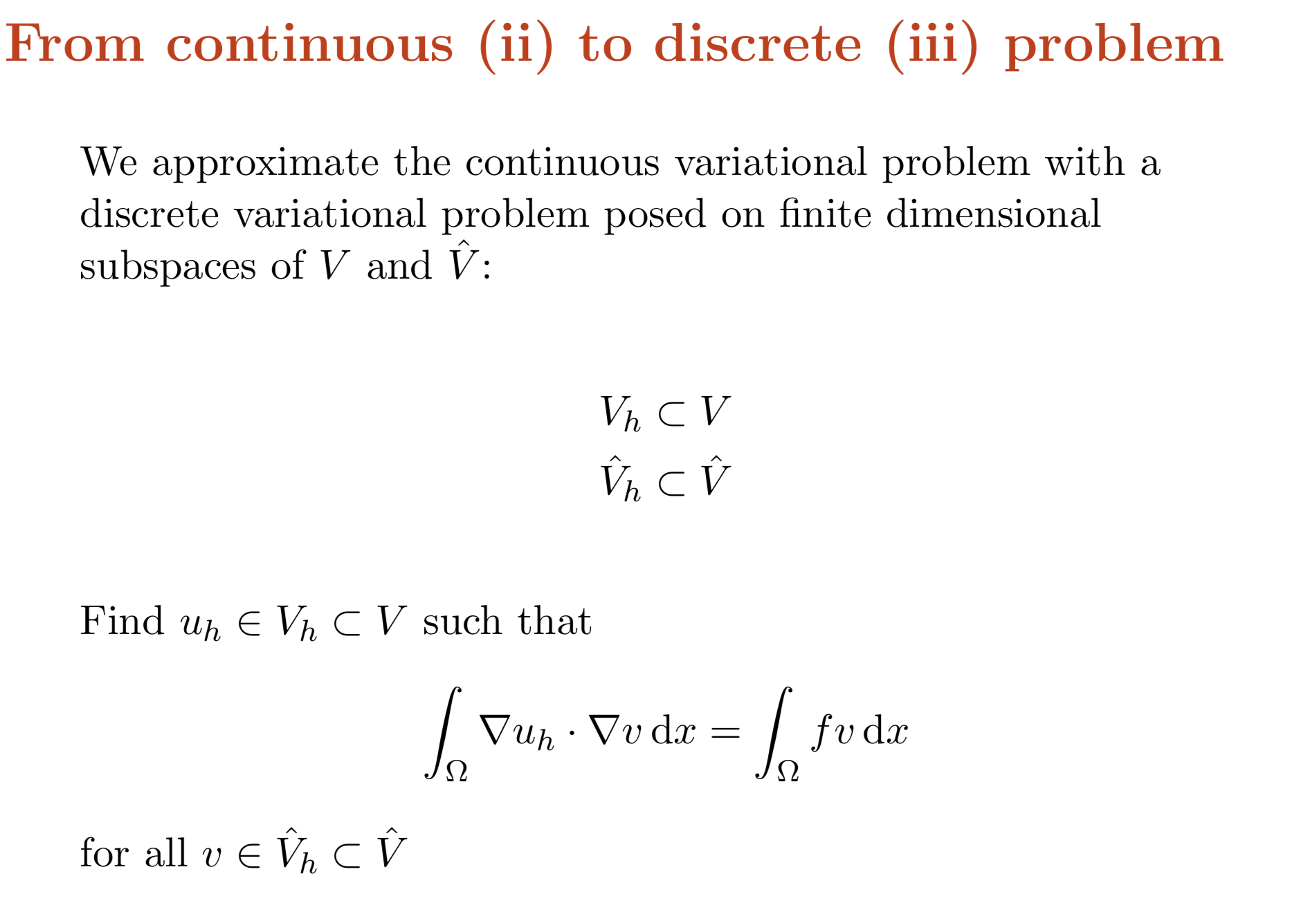

Slide 34
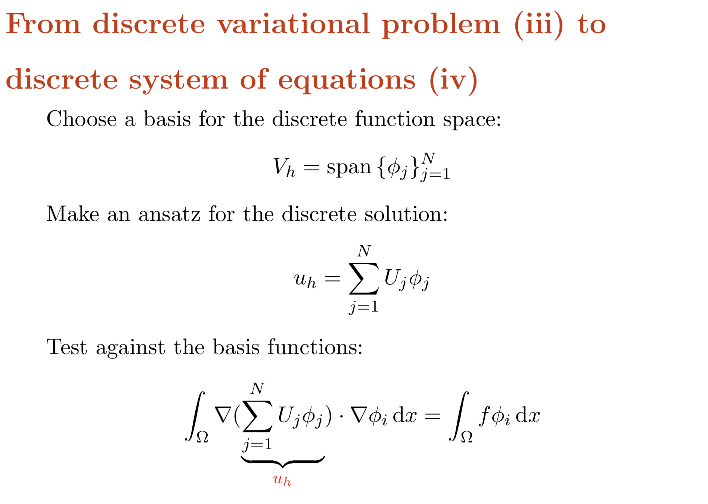

Slide 35
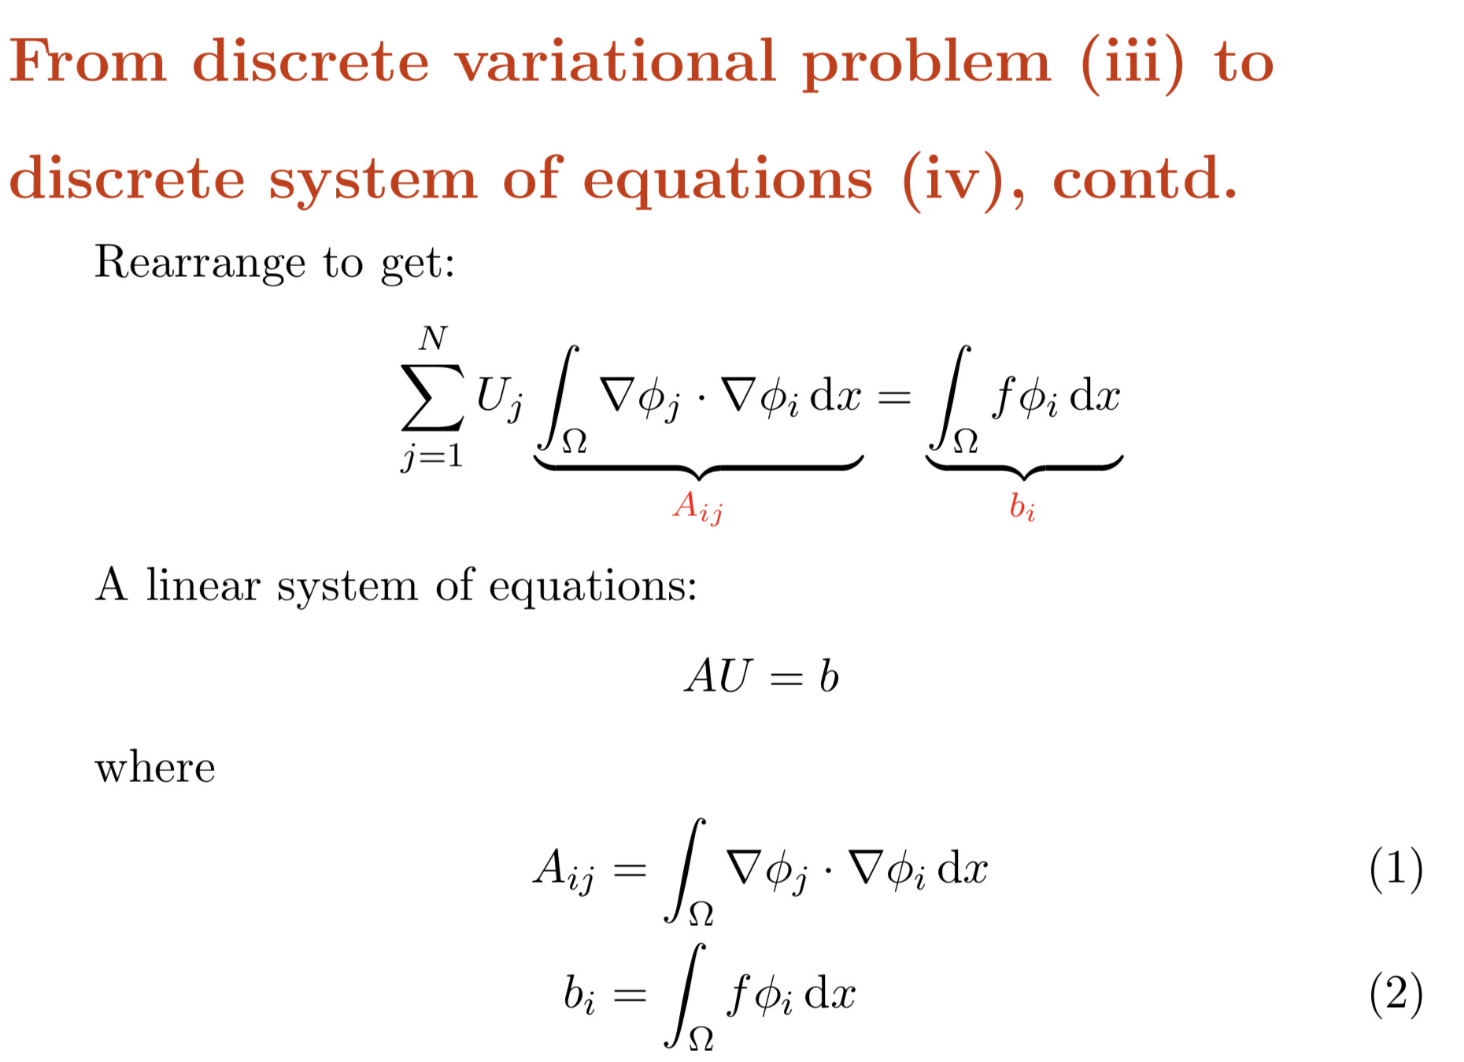

Slide 36
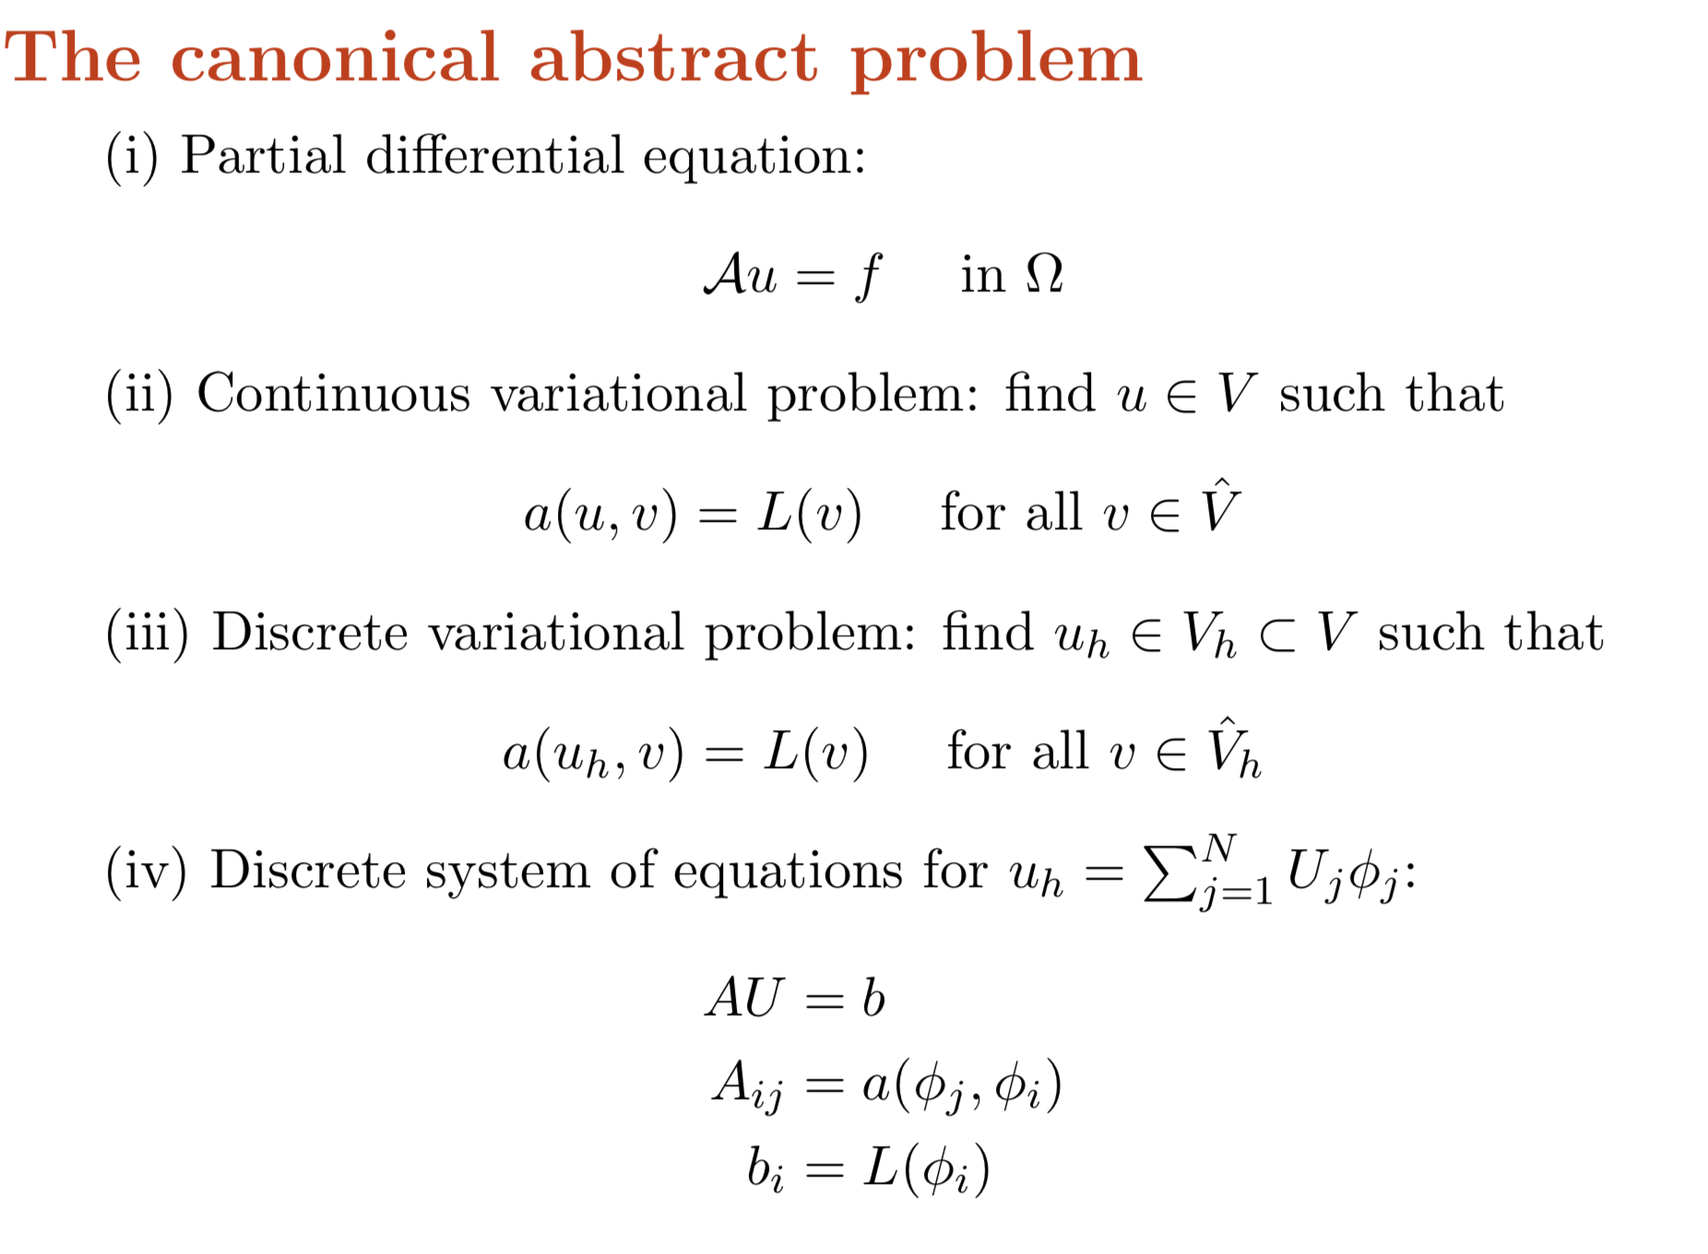

Slide 37
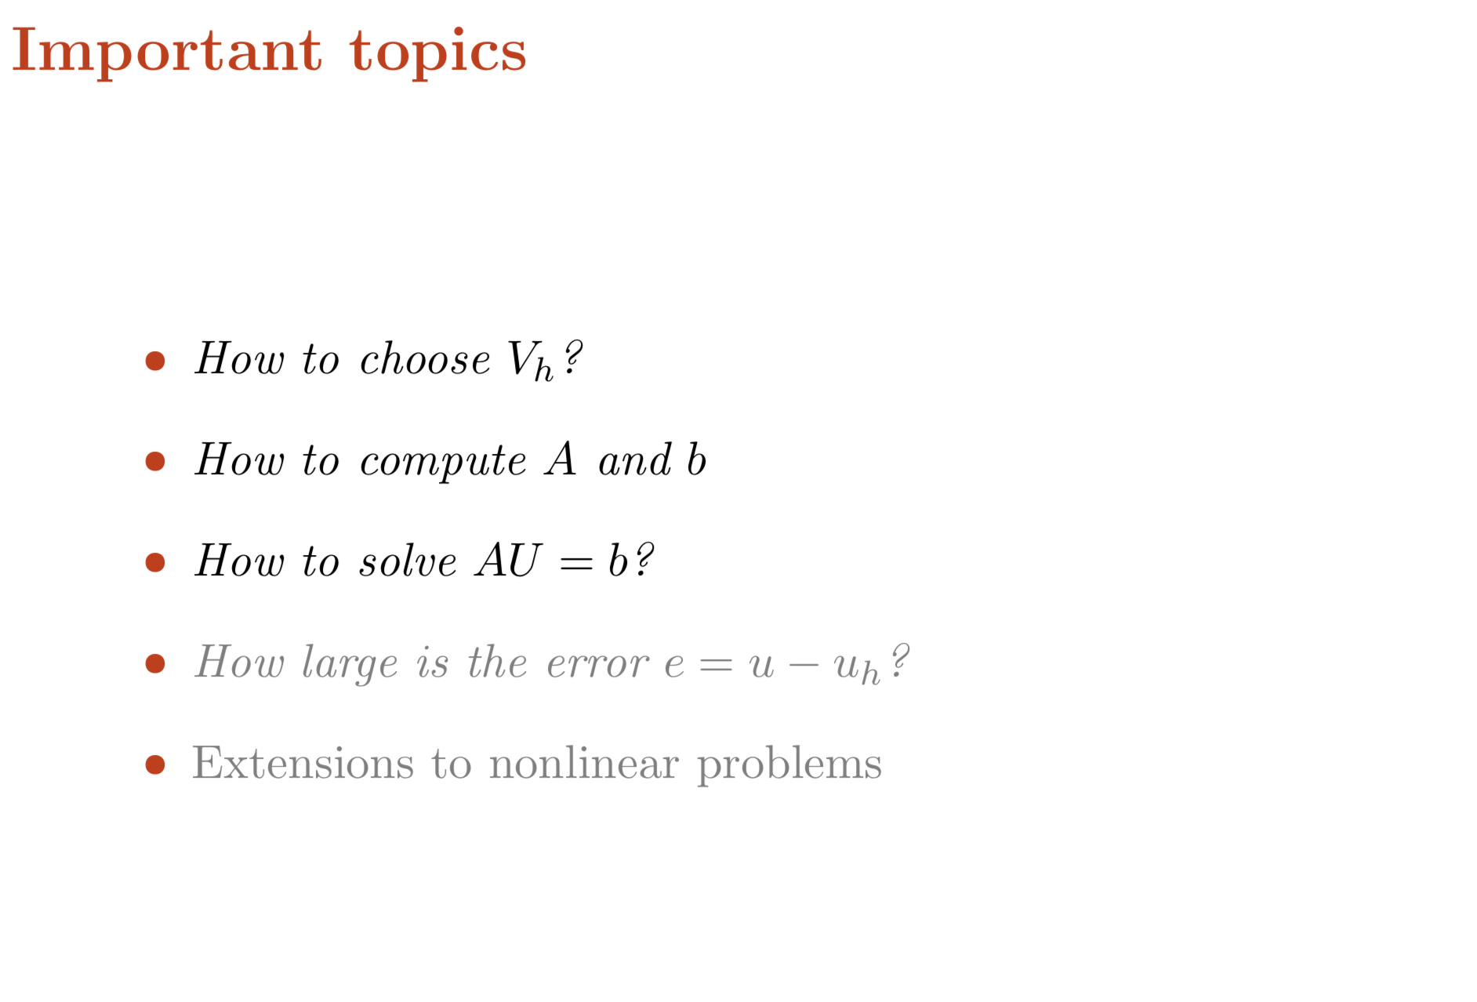

Slide 38
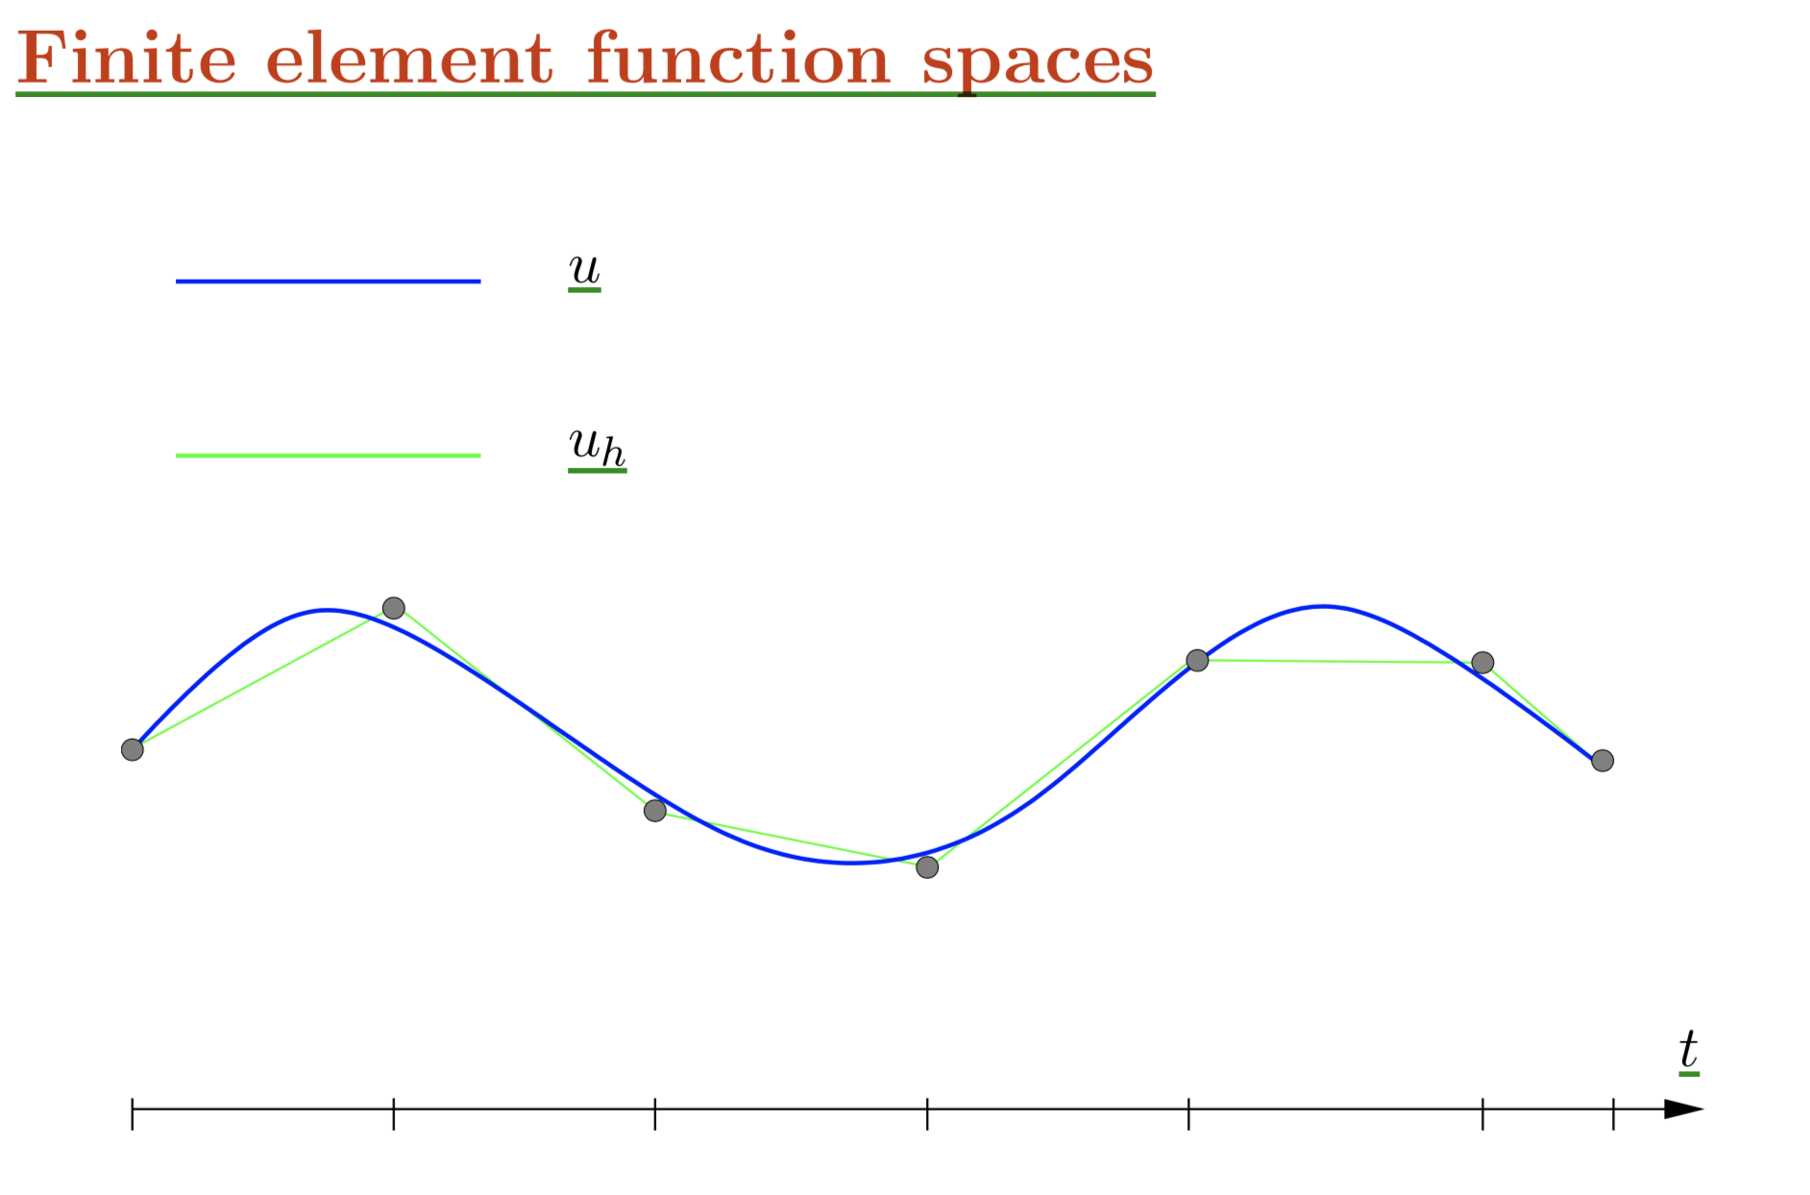

Slide 39
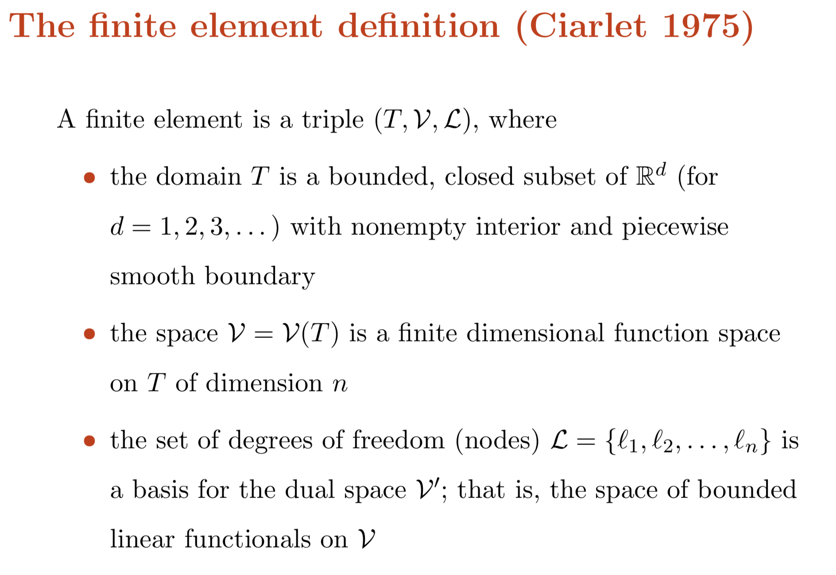

Slide 40
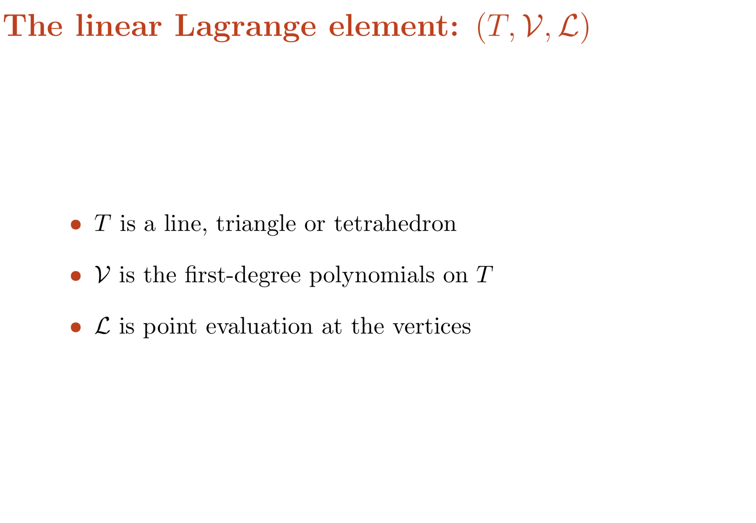

Slide 41
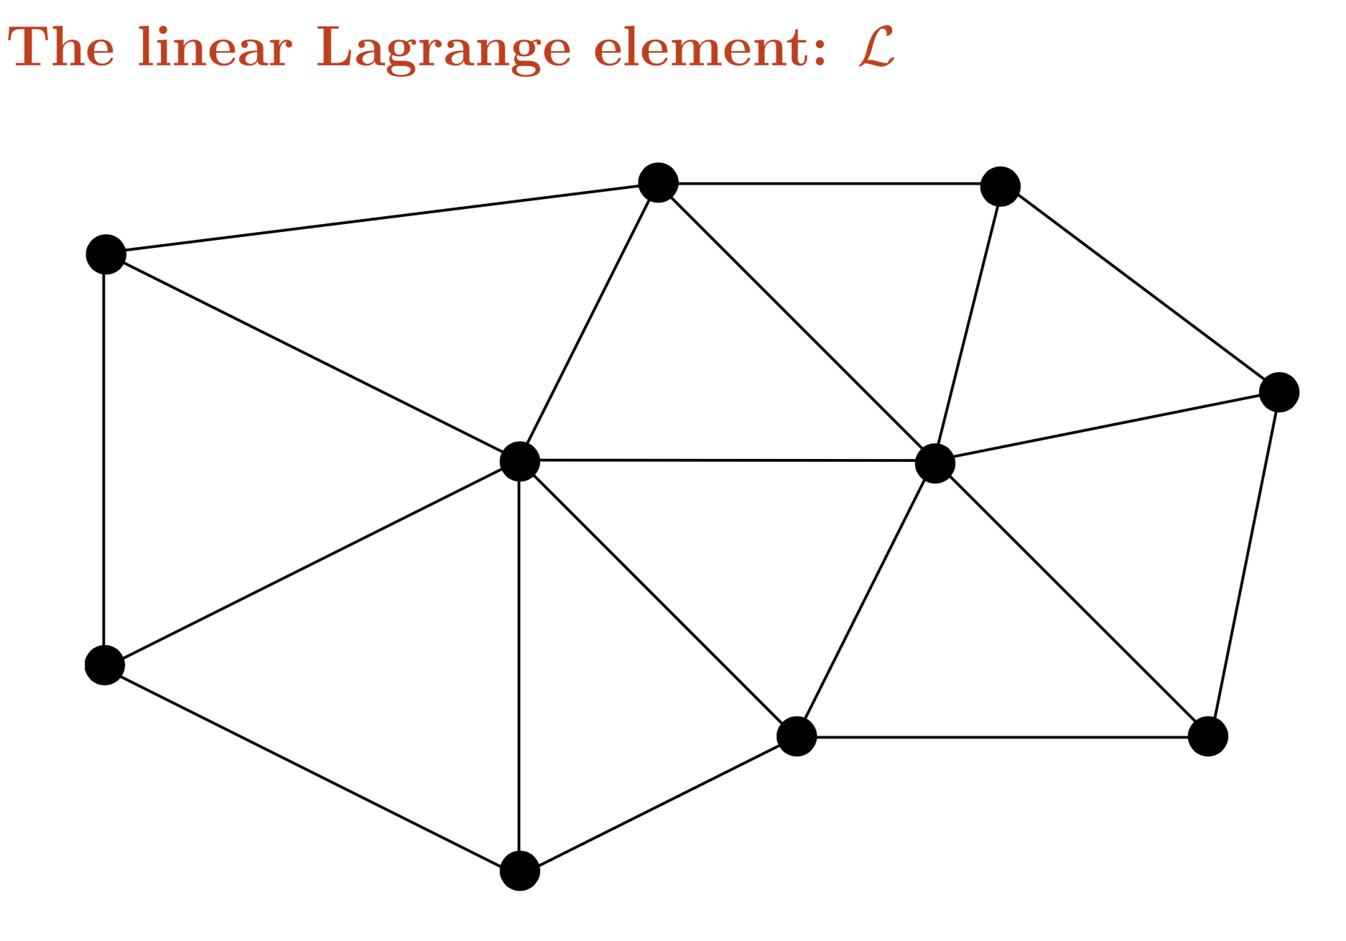

Slide 42
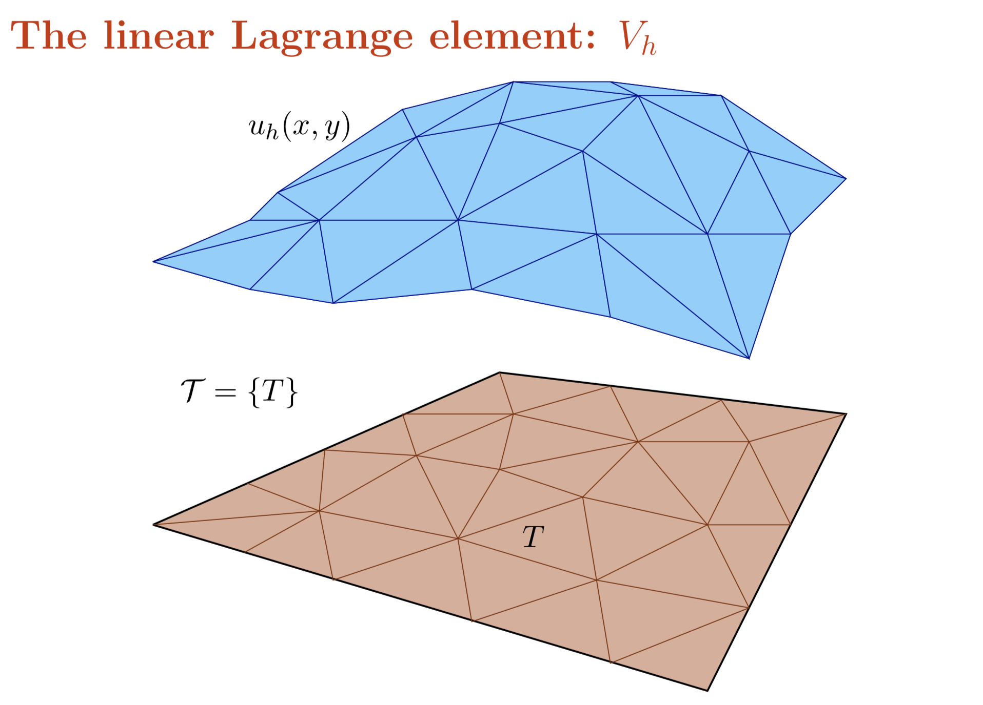

Slide 43
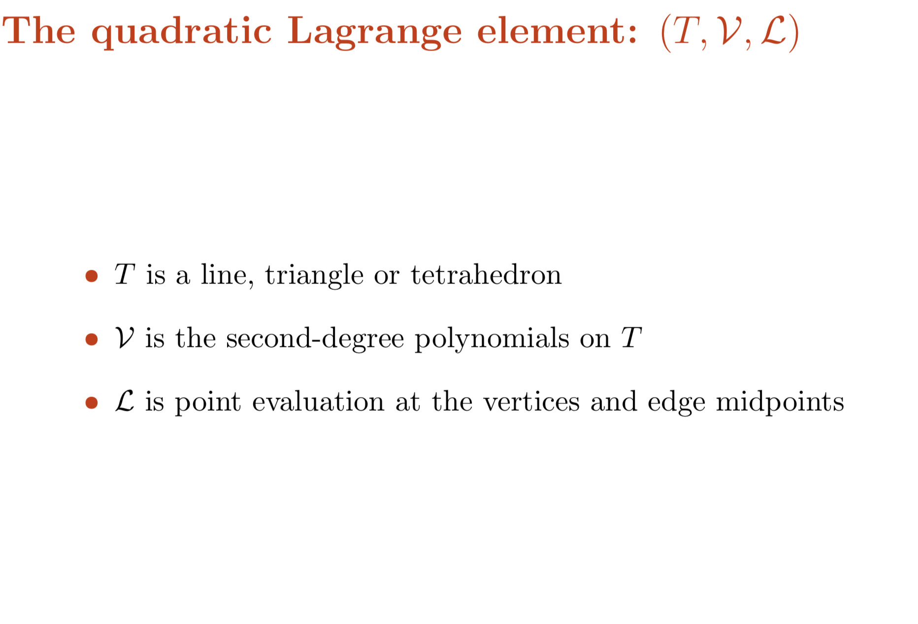

Slide 44
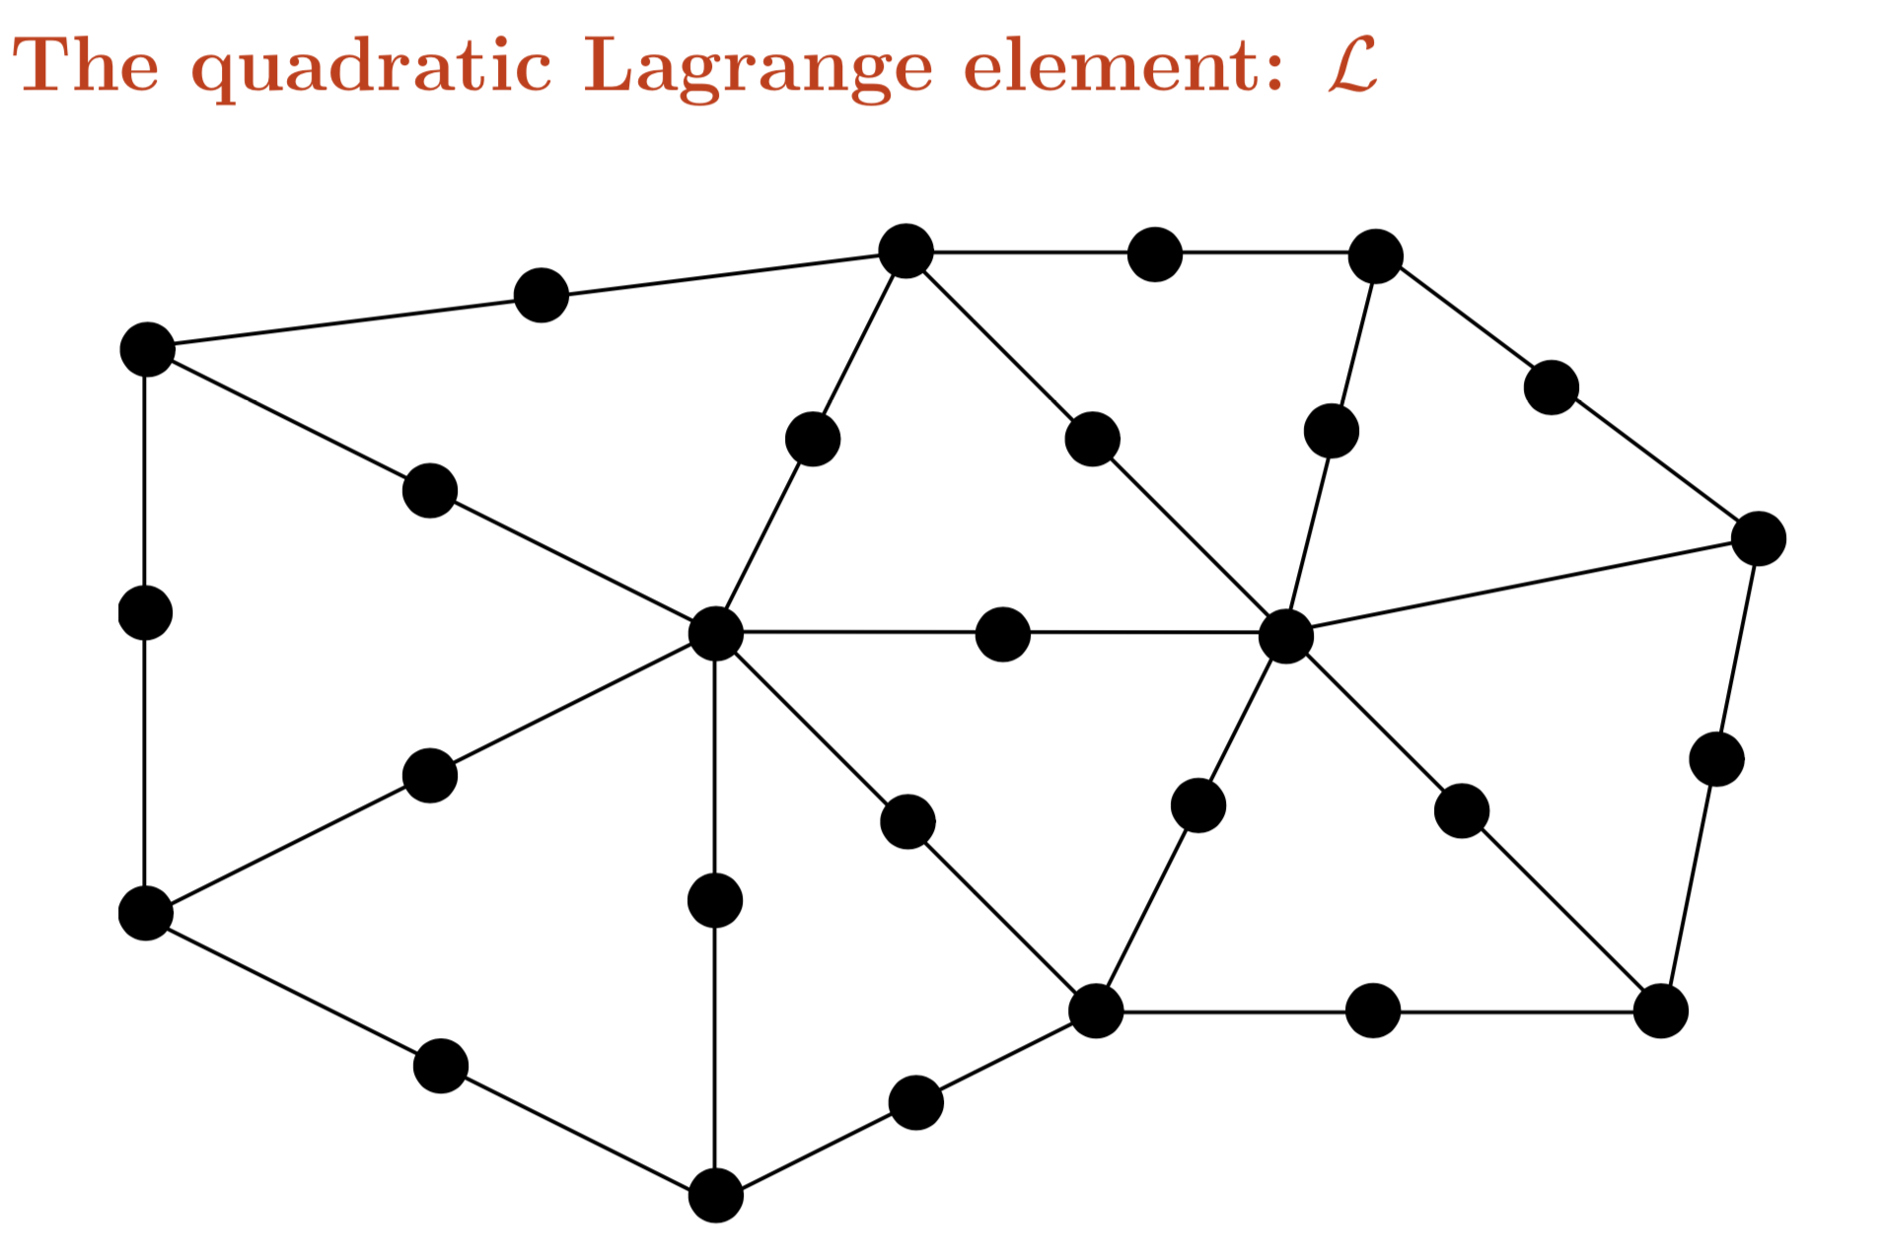

Slide 45
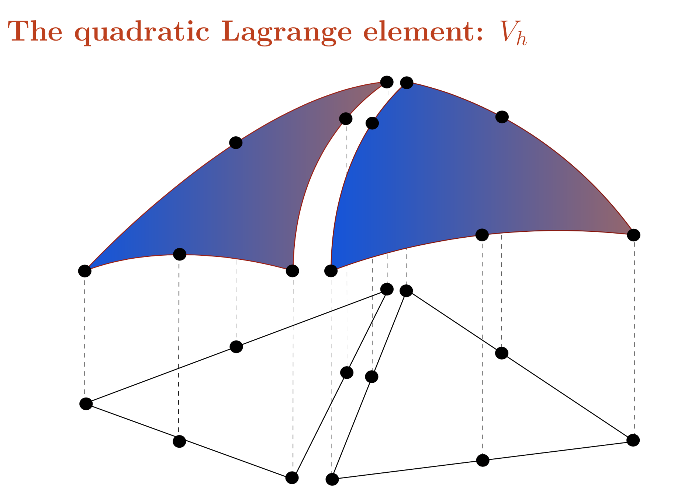

Slide 46
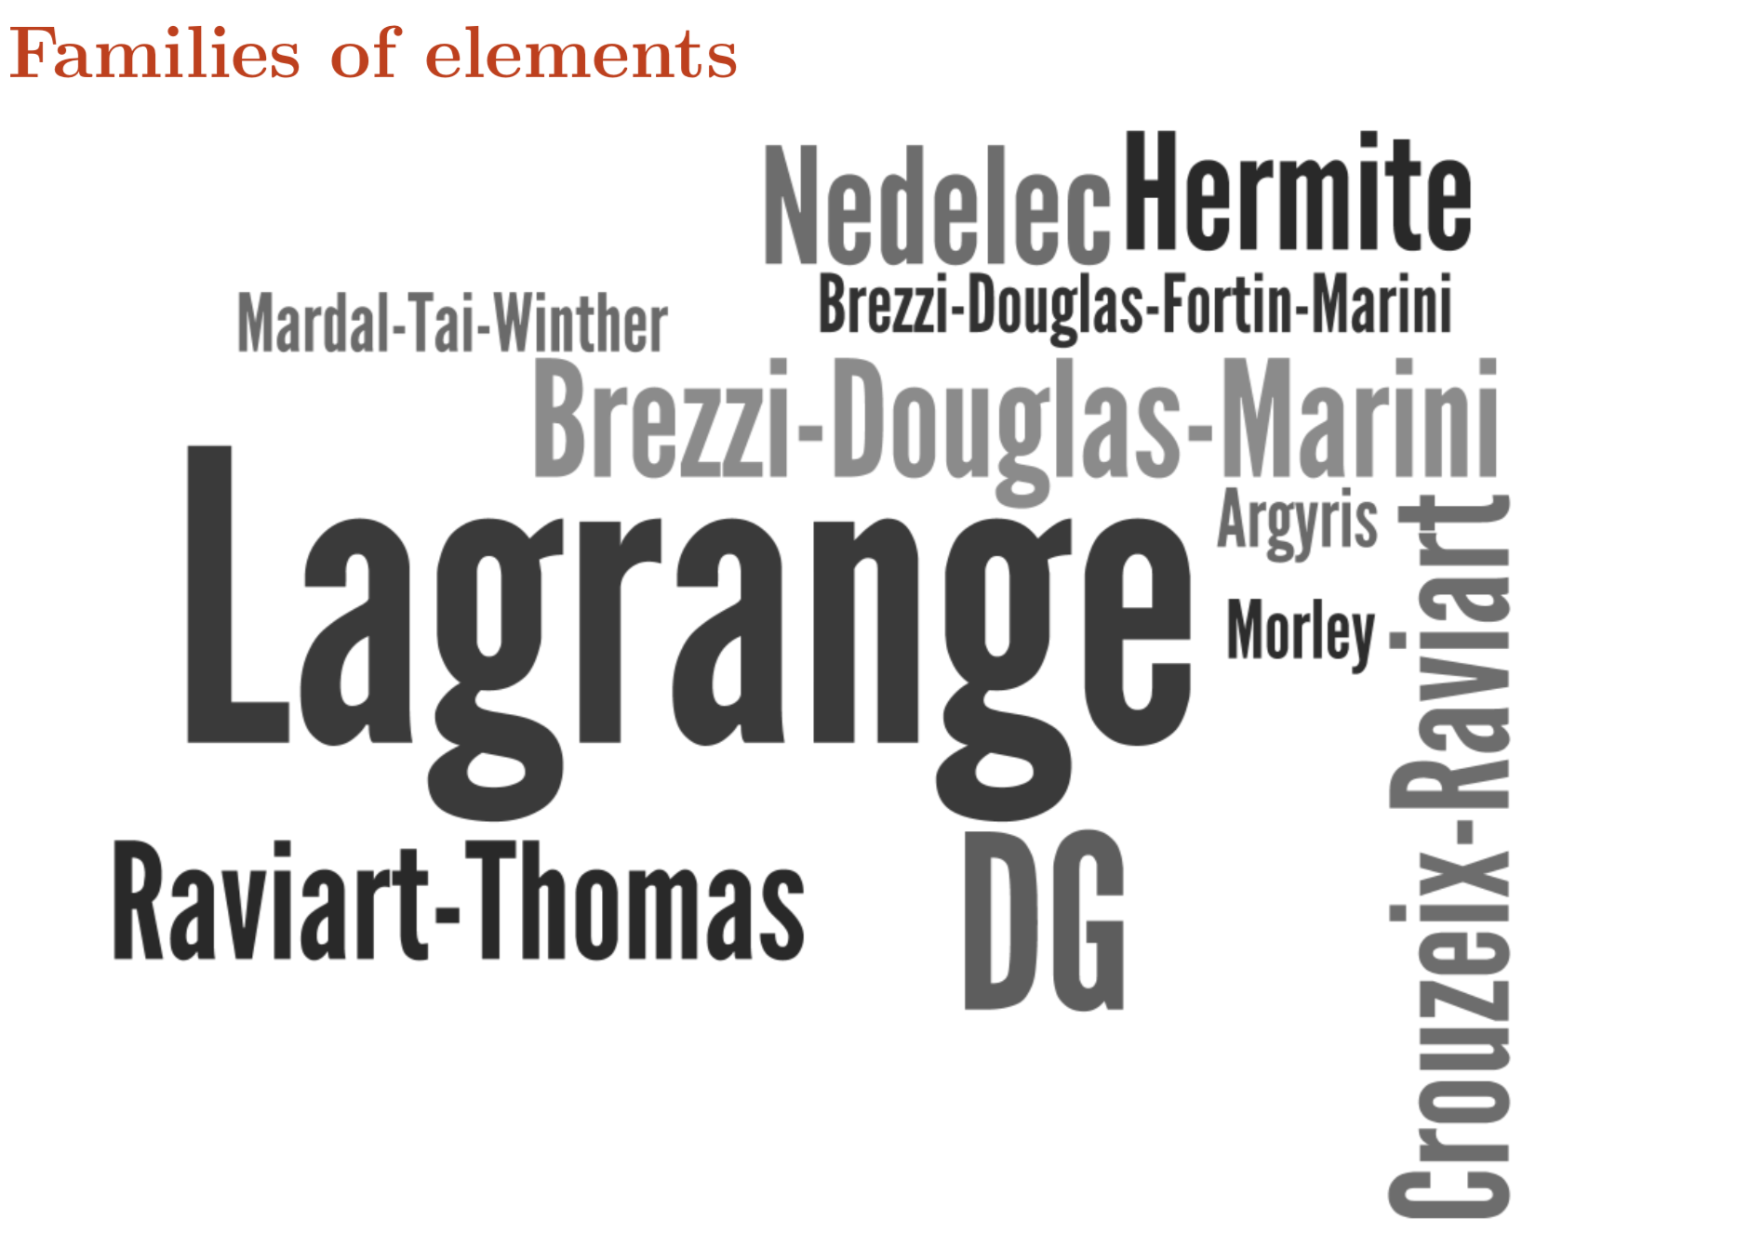

Slide 47
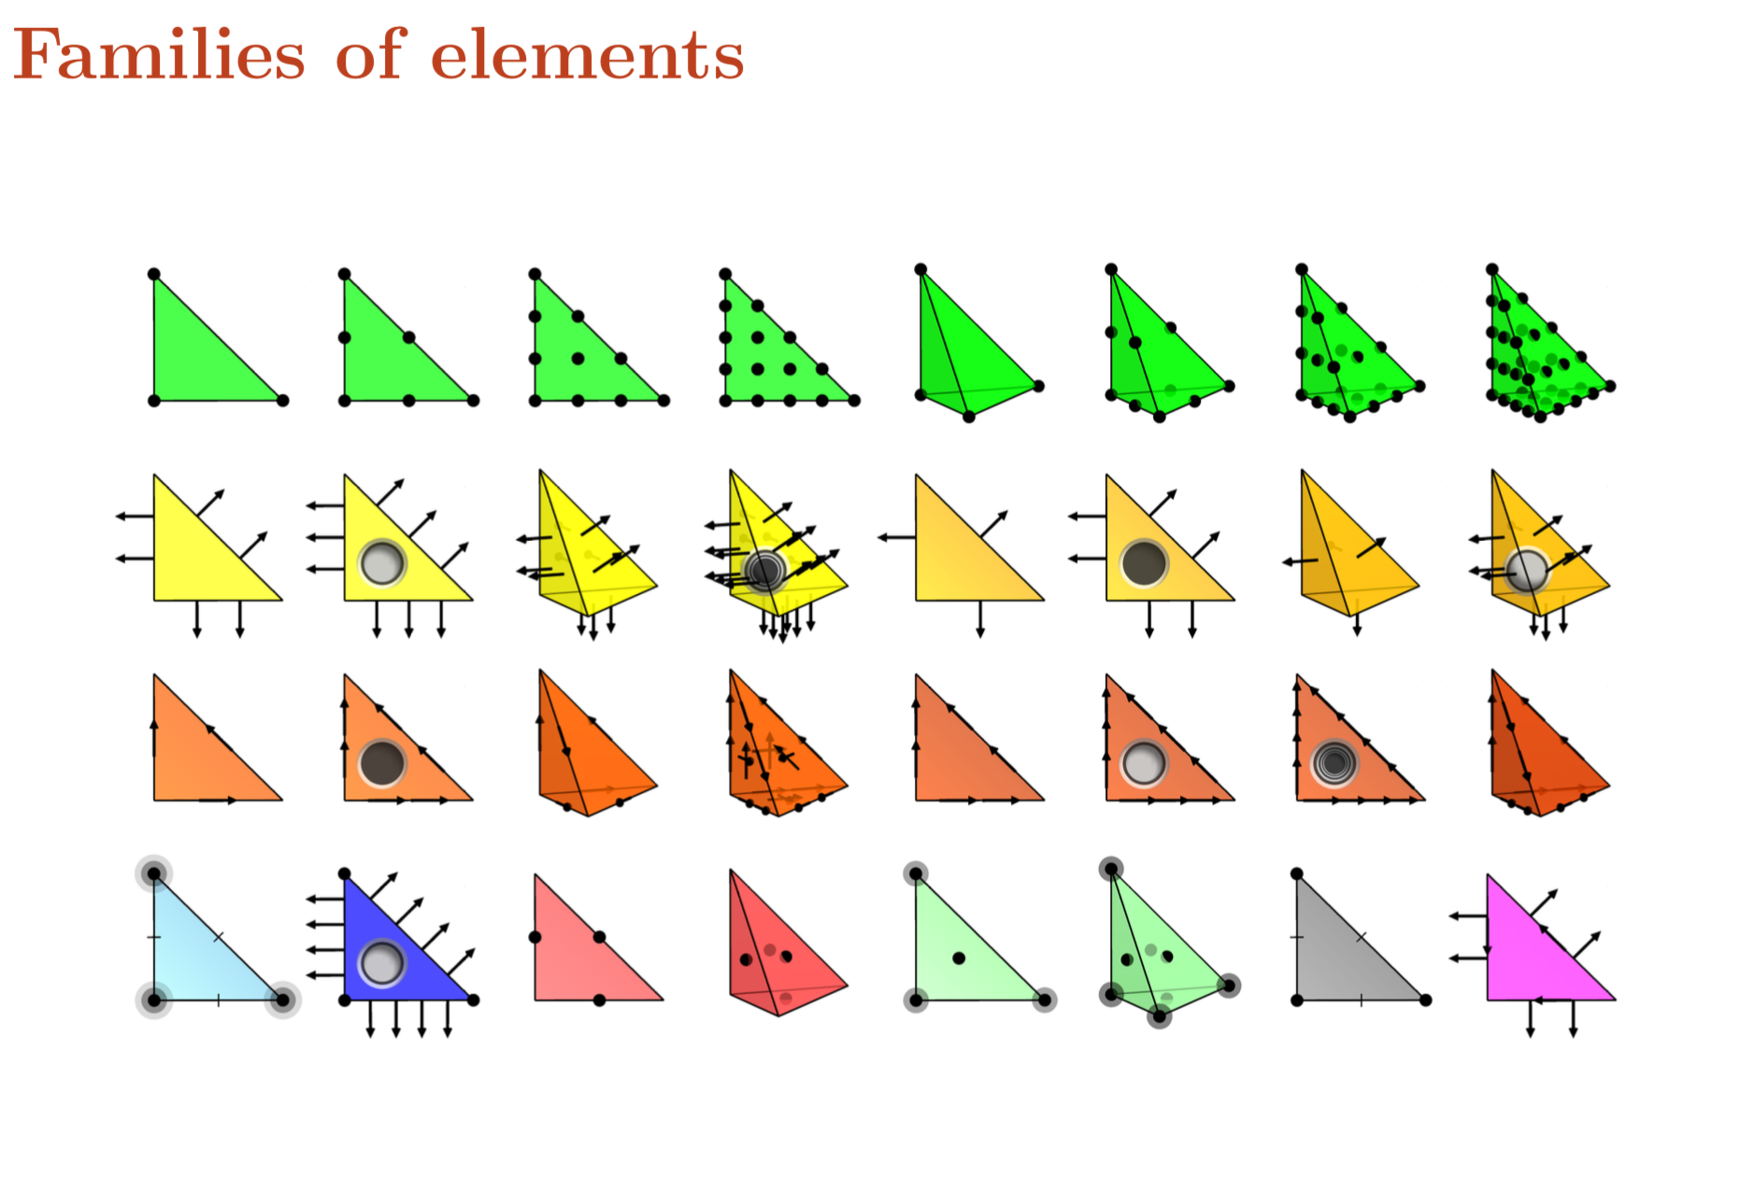

Slide 48
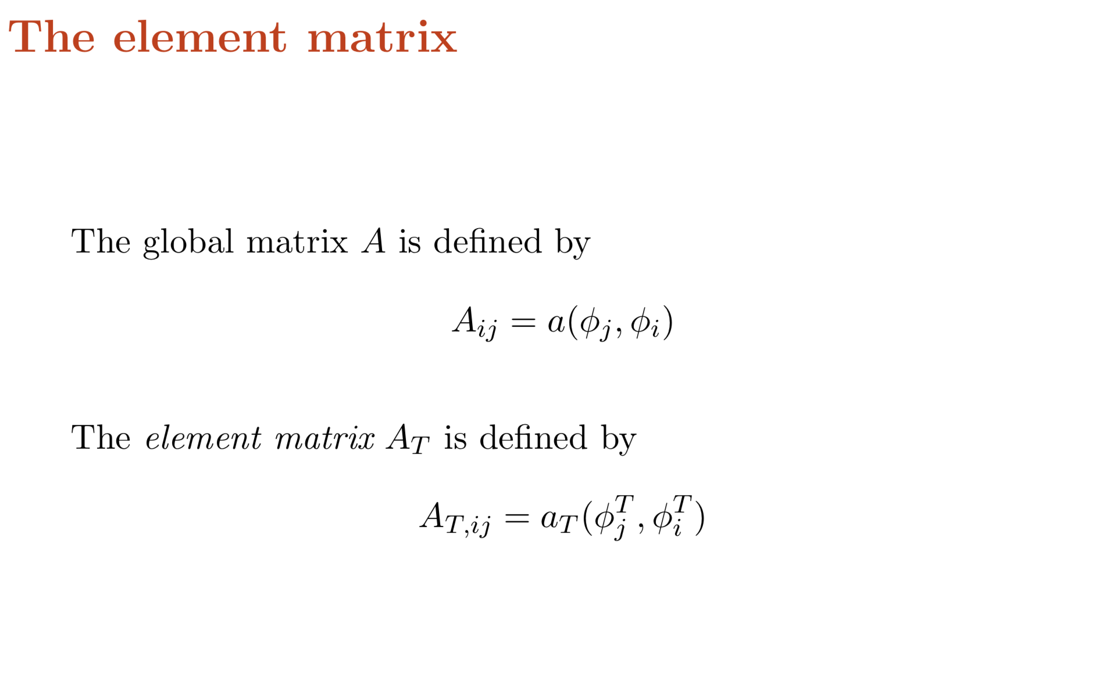

Slide 49
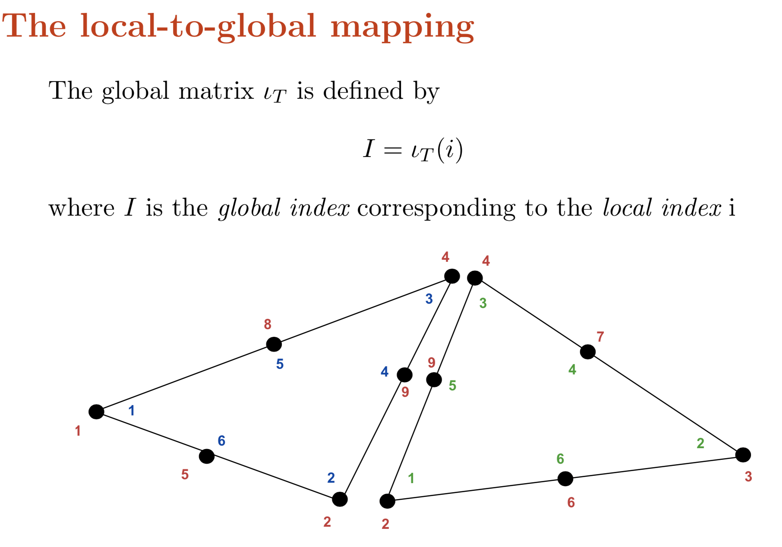

Slide 50
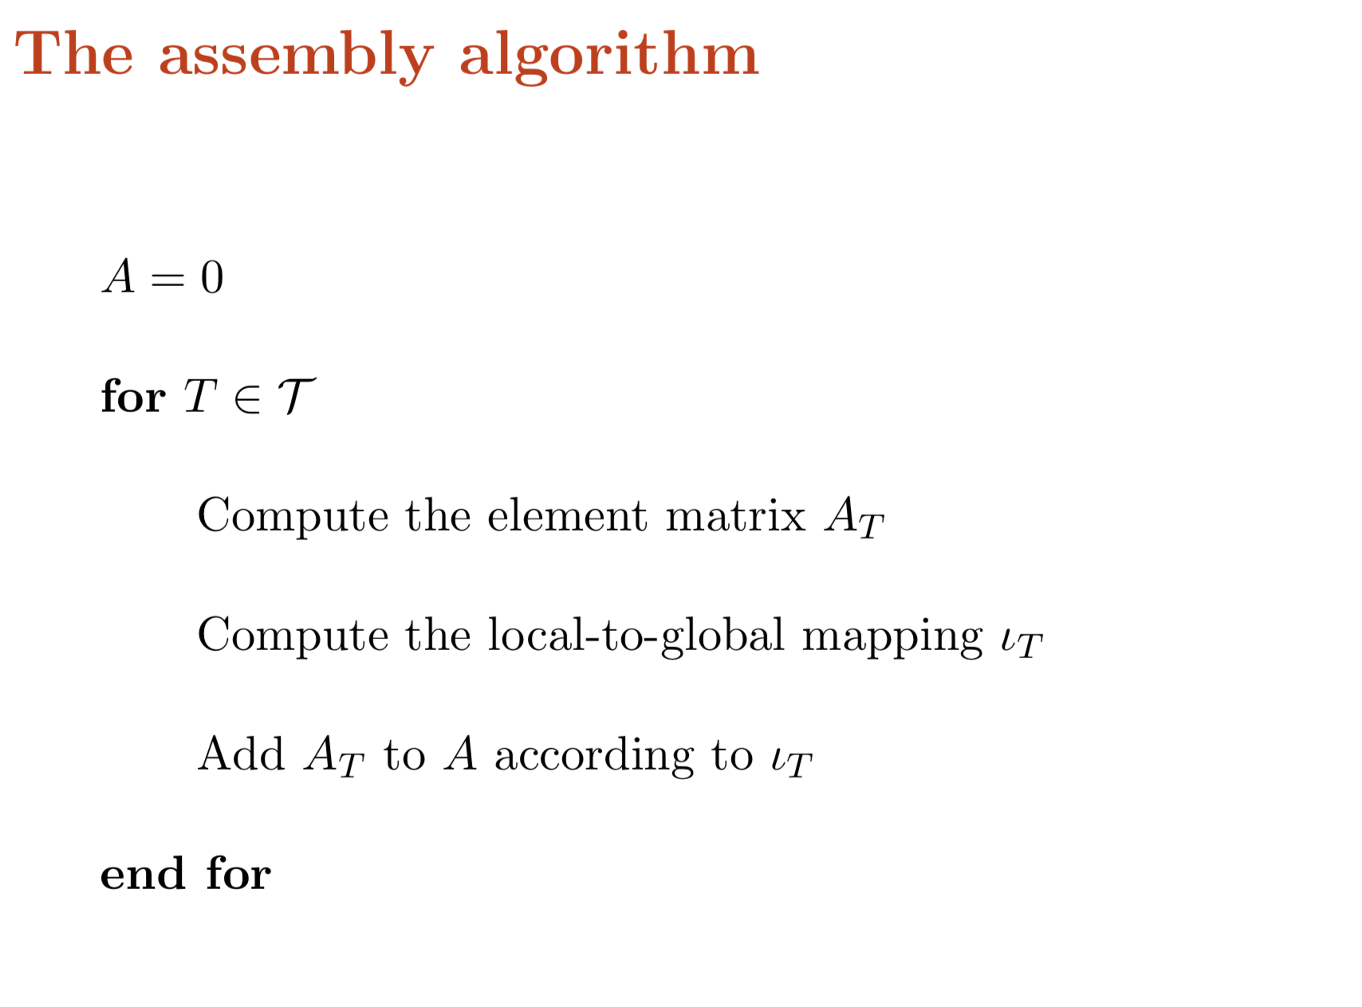

Slide 51
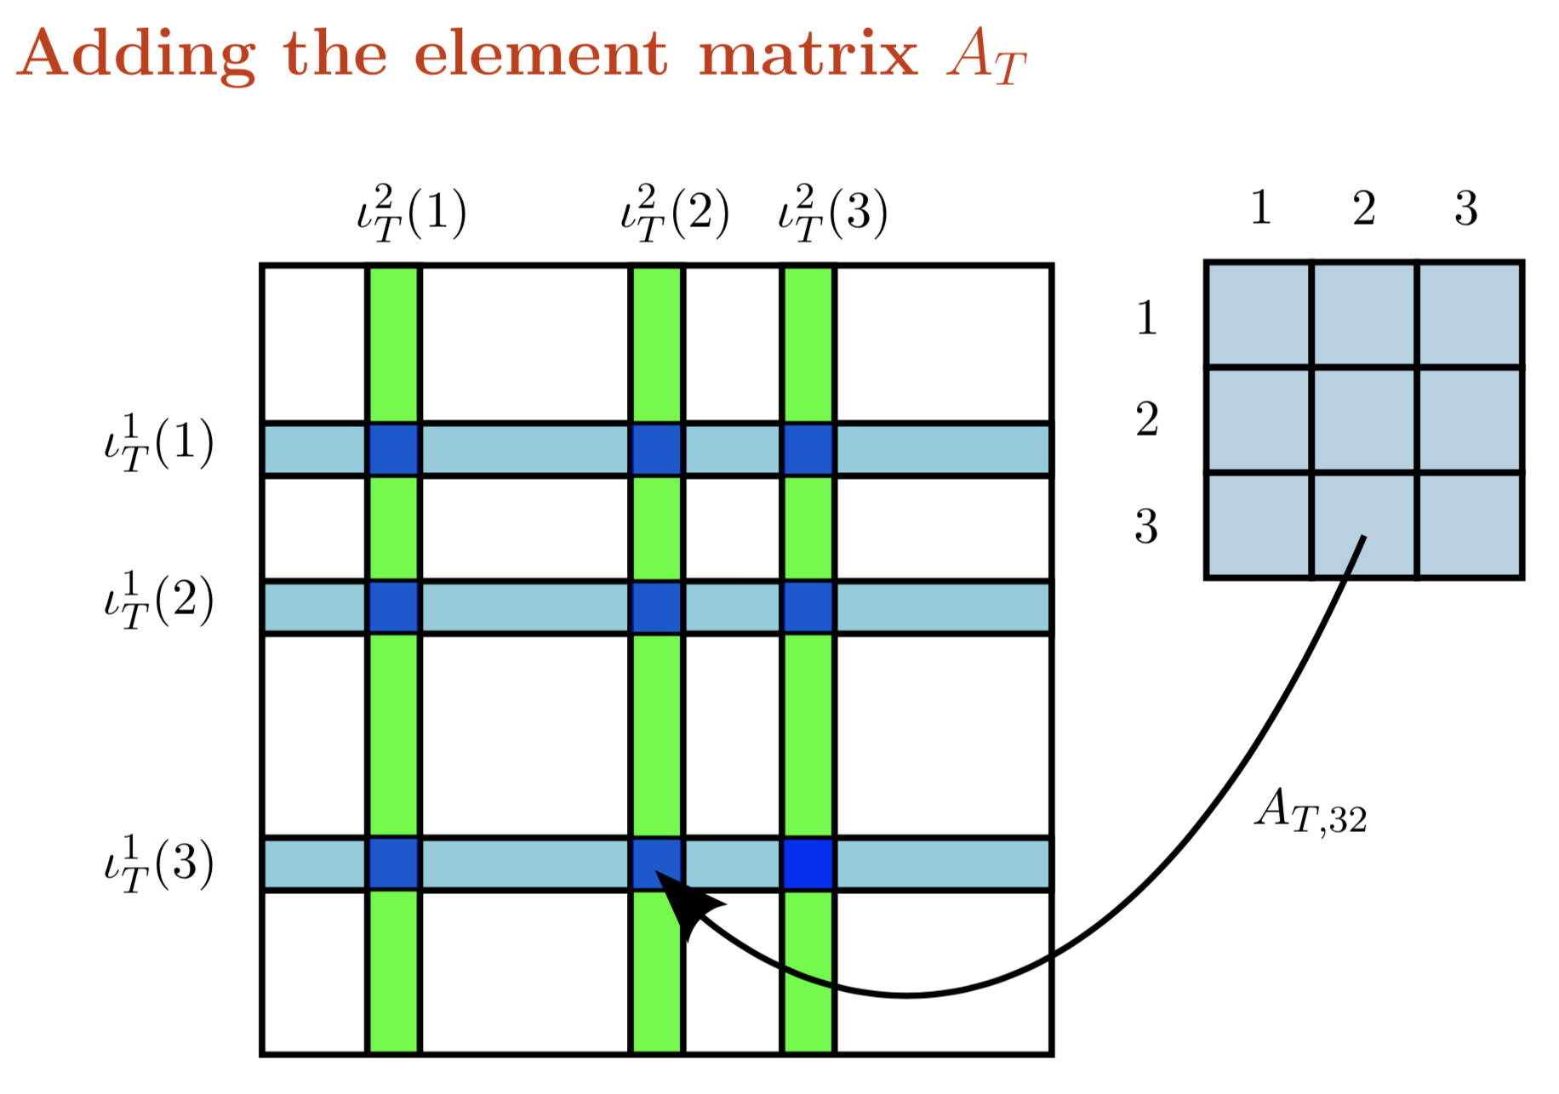

Slide 53
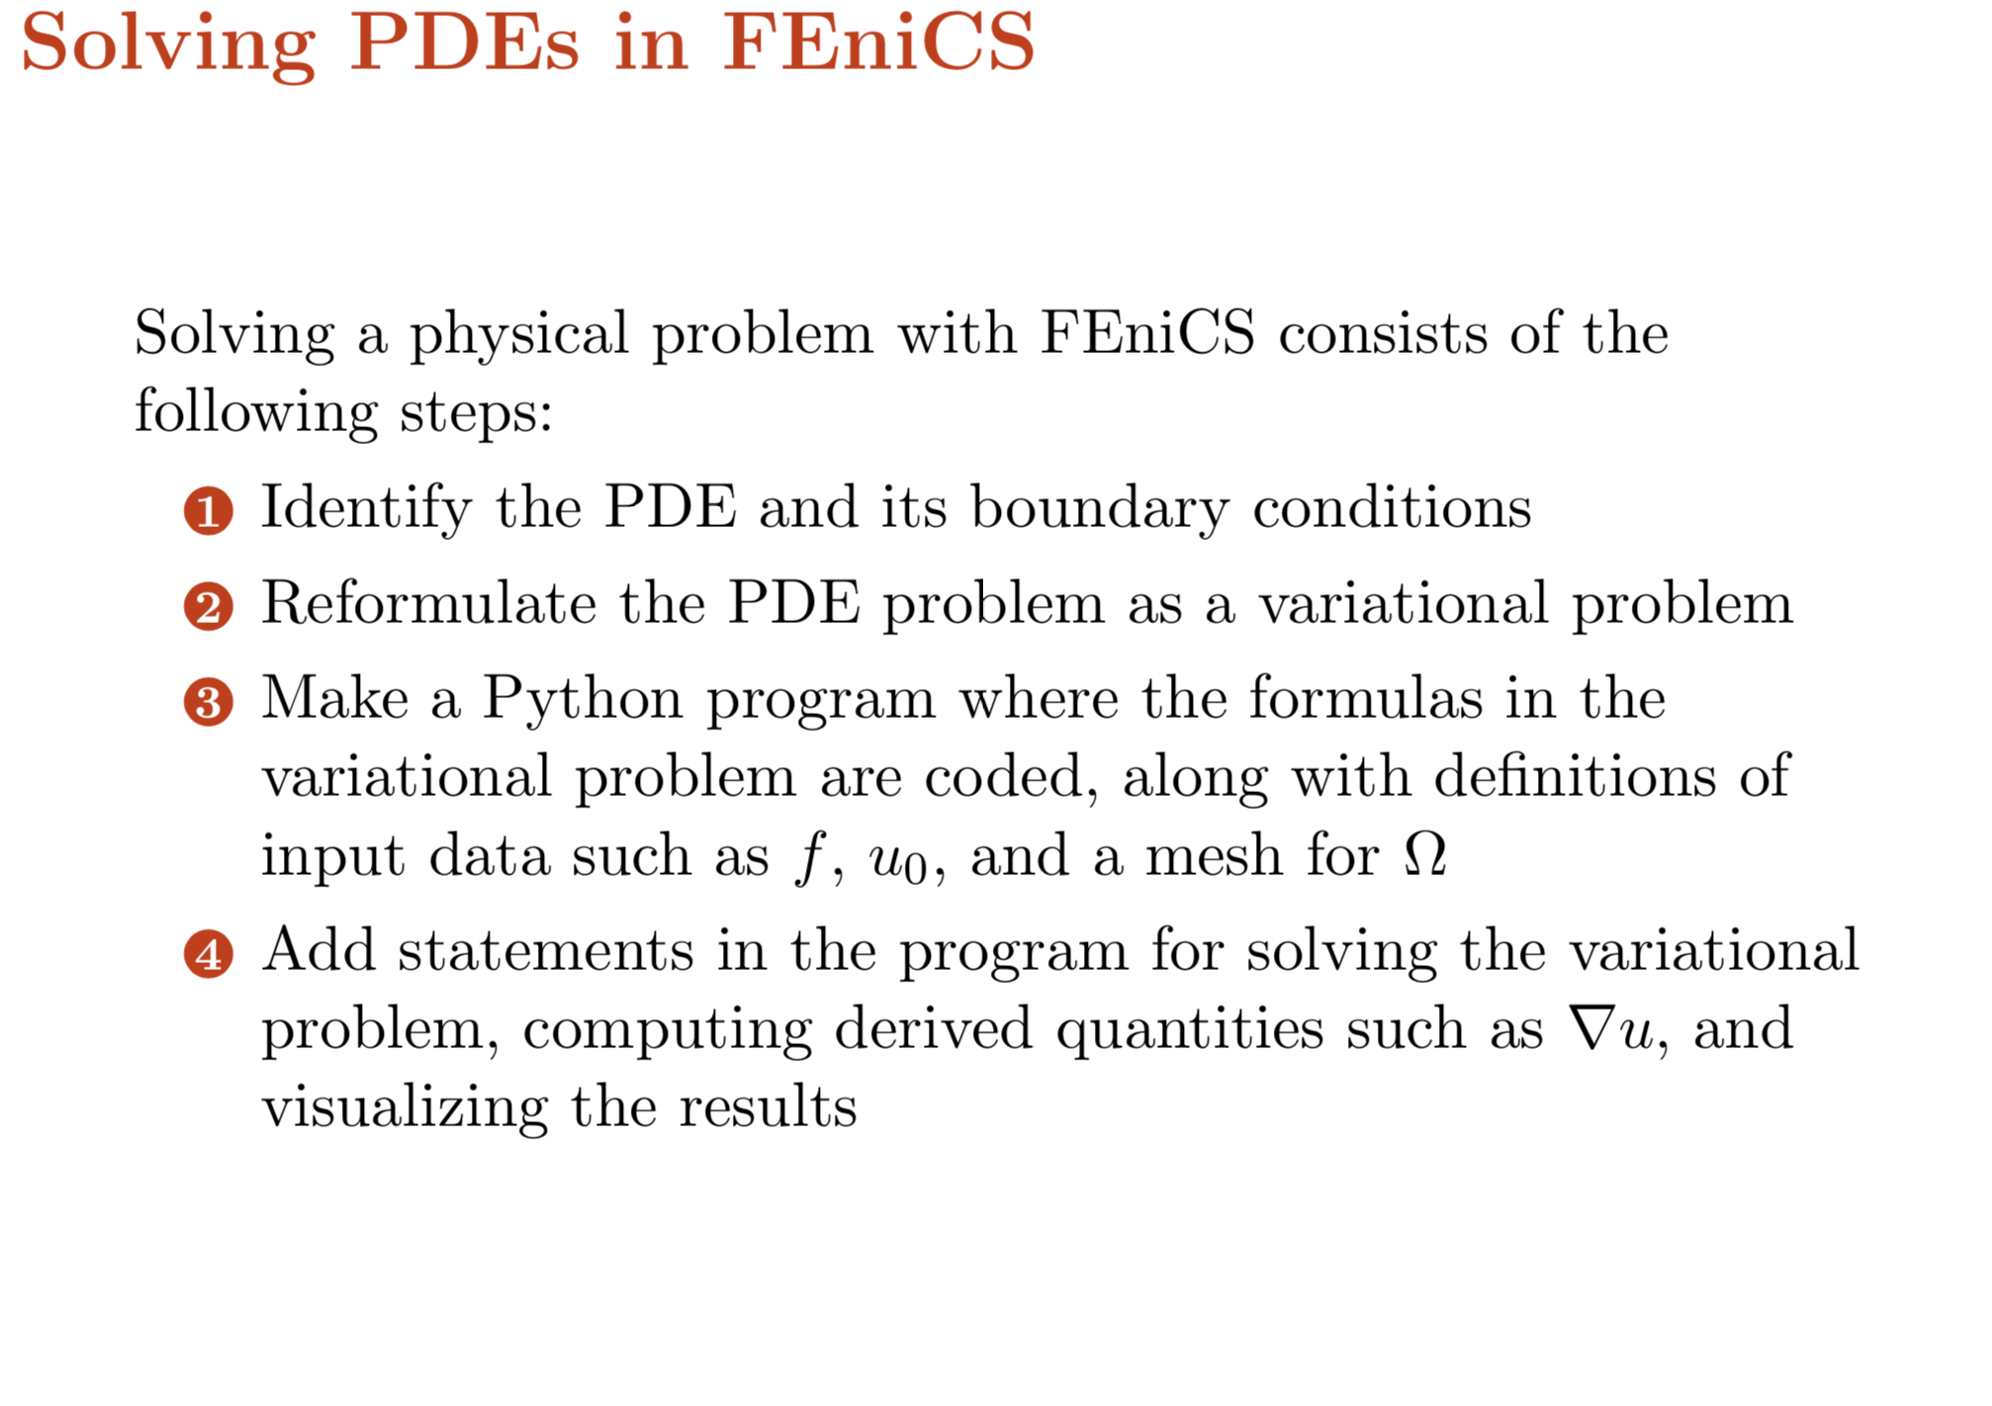

Slide 54
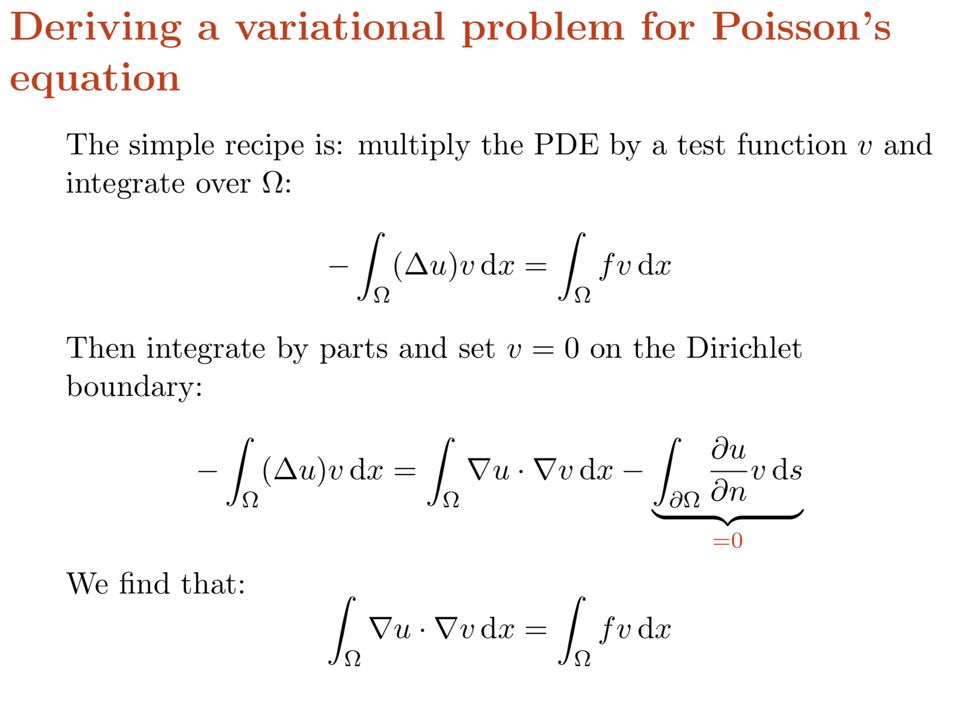

Slide 55
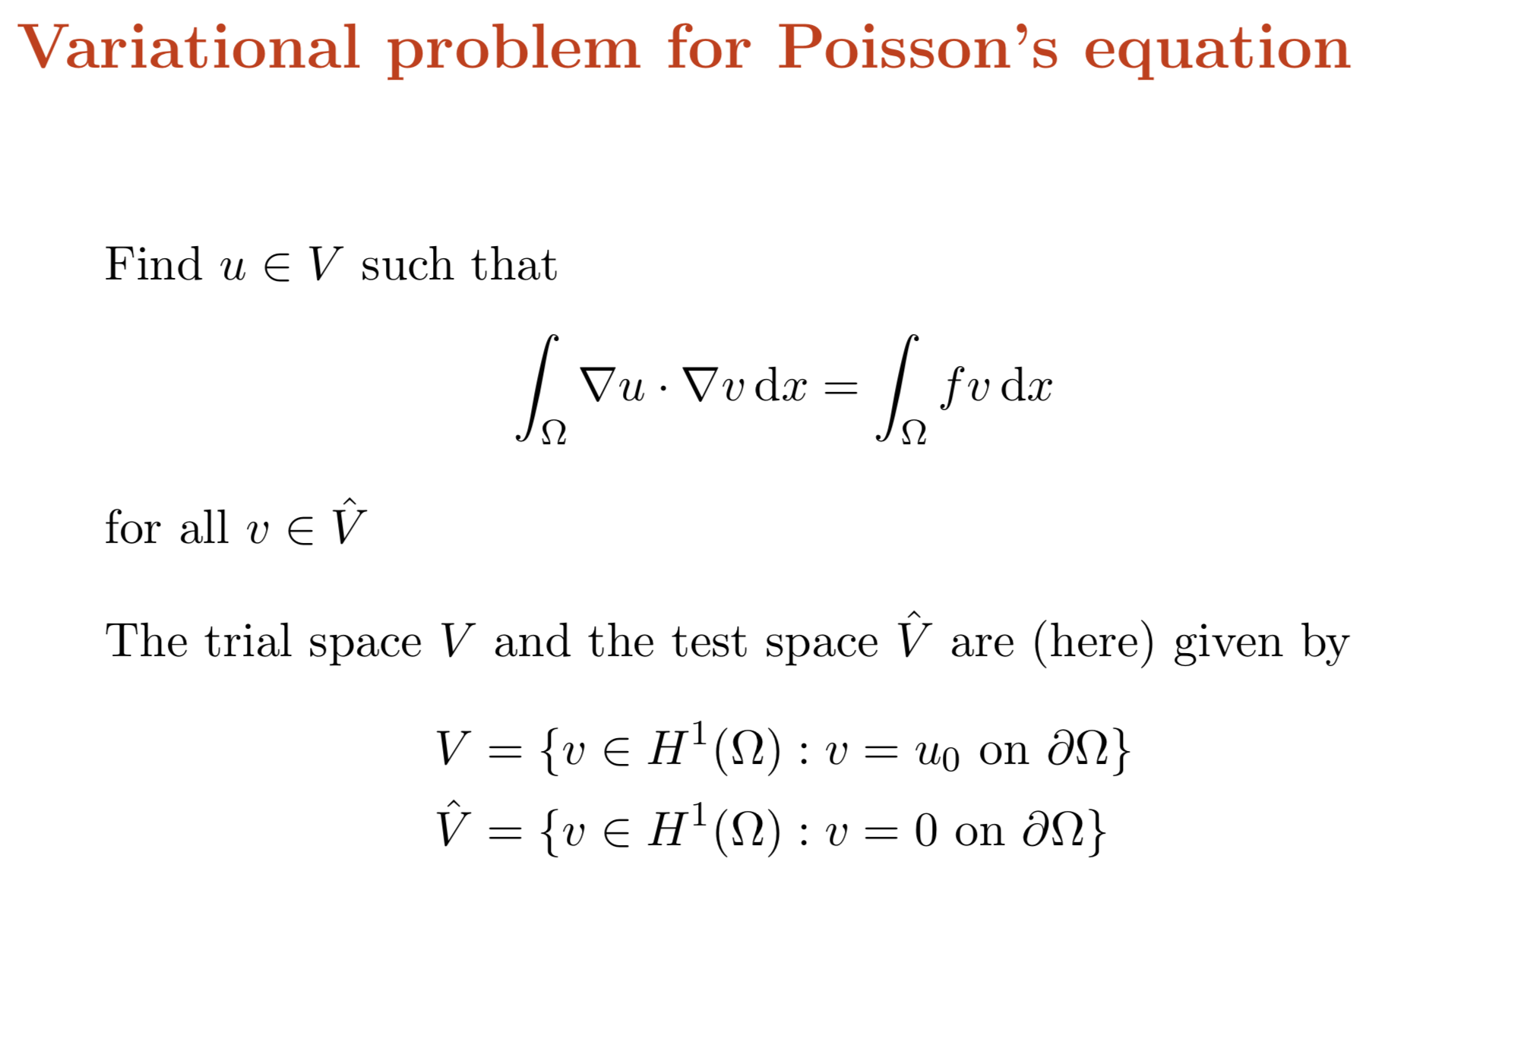

Slide 56
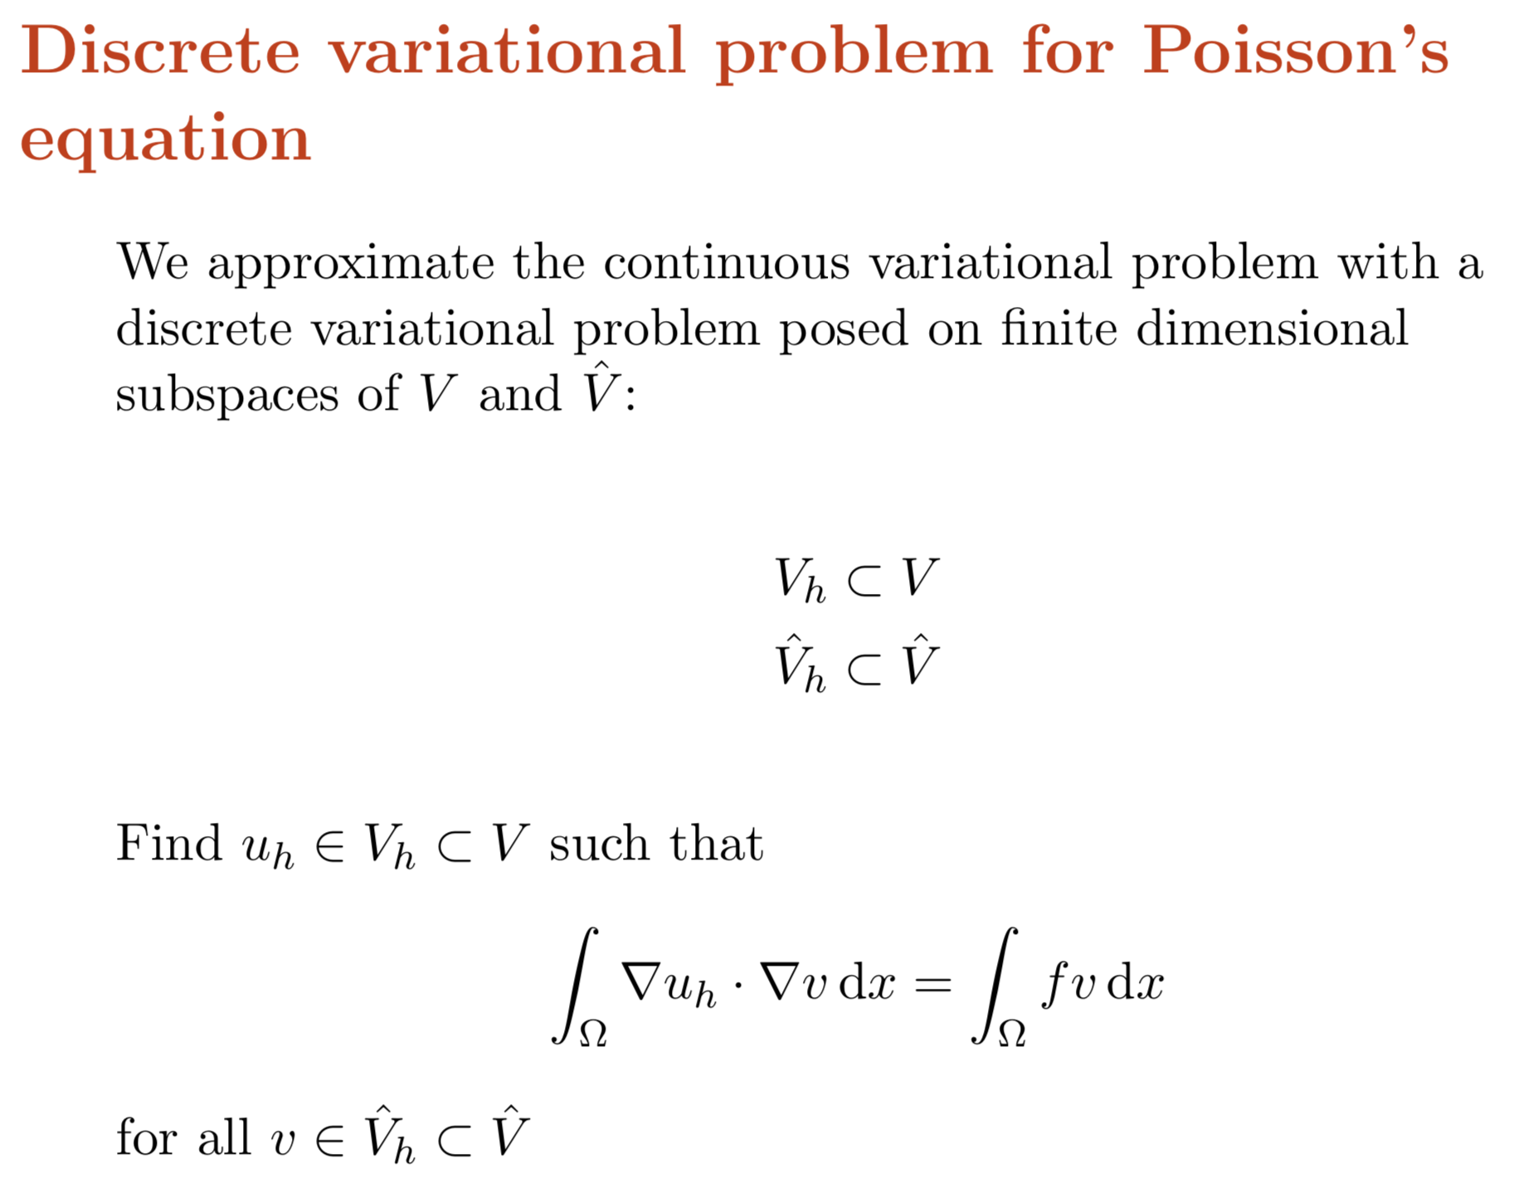

Slide 57
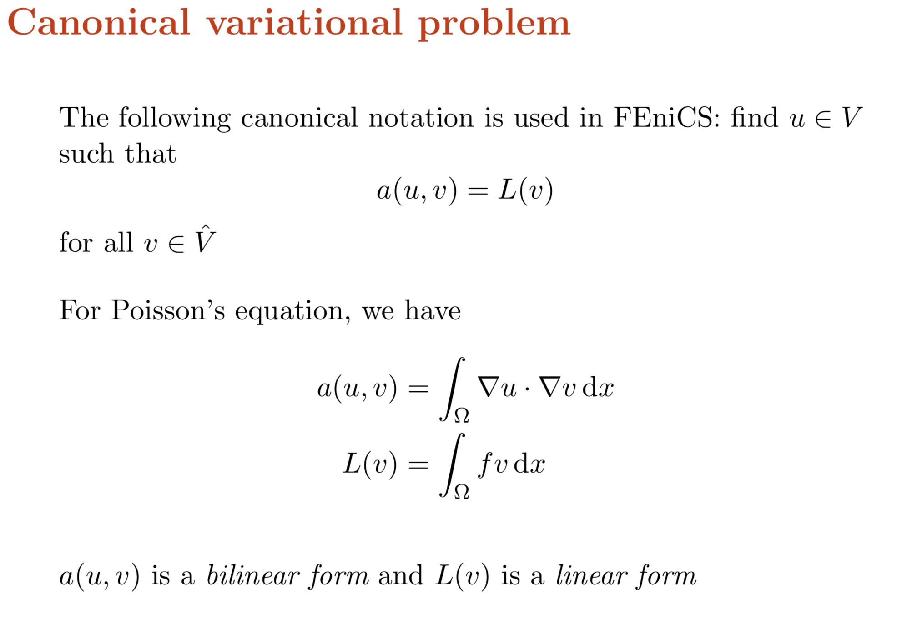

Slide 58


Slide 59




Solve and visualize results in ParaView
Calculate grad(u) field and visualize in ParaView glyph
Impose these BCs using class
How much is flux of grad(u) on the right boundary?

Slide 60


Slide 61


Slide 62


Slide 63


Slide 64


Slide 65


Slide 66


Slide 67


Slide 68


Slide 70



Slide 71


Visualize u in ParaView and extract centerline profile
What are the maximum and minimum value of u; and u(0.5,0.3)=?
Calculate degree-of-freedom and time_to_solution
Calculate L2 and H1 norms

Slide 72


Slide 73
Calculate “rate of convergence” for this problem
Write a bash file for performing h-refinement analysis
Increase polynomial order, how rate of convergence changes?

Slide 75


Slide 76


Slide 77


Slide 78
Preconditioned Krylov solvers is a type of popular iterative methods that are easily accessible in FEniCS programs.
The Poisson equation results in a symmetric, positive definite system matrix, for which the optimal Krylov solver is the Conjugate Gradient (CG) method.
For non-symmetric problems, a Krylov solver for non-symmetric systems, such as GMRES, is a better choice.
Incomplete LU factorization (ILU) is a popular and robust all-round preconditioner.

Slide 79



For the Poisson problem solved earlier, try GMRES-ILU solver

Slide 81


Slide 82


Slide 83


Slide 84


Slide 85


Slide 86


Slide 87


Slide 88


Slide 89


Slide 90


Slide 91

Write the code for above transient diffusion problem using backward Euler methods.
Visualize results for the first 3 seconds, with dt = 0.1 in ParaViw.
Compute the same solution on a same setup
for a cubic domain.
Solve this problem in a square domain with
square-hole in the center.

Slide 93








Slide 94



Slide 95


Slide 96


Slide 97



Slide 98




Slide 99





Slide 100
Using Picard method
Using Newton’s methods
Compare maximum errors for Picard and Newton

Slide 102




Slide 103




Slide 104


Slide 105


Slide 106



Use continuous Galerkin weak form
and calculate total flux at production
The well.
Visualize p and v fields in ParaView

Slide 108


Slide 109



Slide 110



Slide 111



Slide 112



Slide 113



Slide 114

Use RT0 mixed finite element
and solve the reservoir problem

Slide 115


